Slide 1
Econ 642: Week 1
Introduction and Gross Domestic Product

Slide 2
Overview of the Course
Gross Domestic Product
Economic Growth
Solow Growth Model
Microeconomic Topics
Consumption
Labor
Investment
General Equilibrium
Monetary Topics
Money and Inflation
Business Cycles
Real Business Cycle
Sticky Prices and IS-LM
The Open Economy

Slide 3
Overview of the Course
Questions that we will assess to understanding the aggregate economy in the short-run and long-run
How do we measure economic activity and what isn’t included?
Why do some countries grow and why does growth differ?
How do people make consumption, investment, and labor decisions?
What determines inflation and unemployment
Why are there expansions and recessions in the economy?
How does government monetary and fiscal policy affect economic activity?
How does open economy impact economic activity?

Slide 4
Overview of Lecture
Gross Domestic Product, GDP Accounting, and Value Added
Making Comparisons
The Human Development Index
Beyond GDP

Slide 5
Gross Domestic Product
Kurlat Chapter 1

Slide 6
Gross Domestic Product
The Basic Question
How do we measure economic activity and what isn’t included?
Answer
Gross Domestic Product (GDP)
A measure of a country’s total goods and services produced
This is the basic measurement of economic activity
GDP can be constructed in three ways
Production
Income
Expenditures

Slide 7
Three Ways to Construct GDP
Production | Income | Expenditures
Agriculture & Mining | Employment Compensation | Consumption
Construction | Proprietor’s Income | Investment
Manufacturing | Rental Income | Government
Services | Corporate Profits | Net Exports (Exports-Imports)
Government | Interest Income
(Think NAICS) | Depreciation*
*Depreciation in capital is accounting for capital deterioration over time

Slide 8
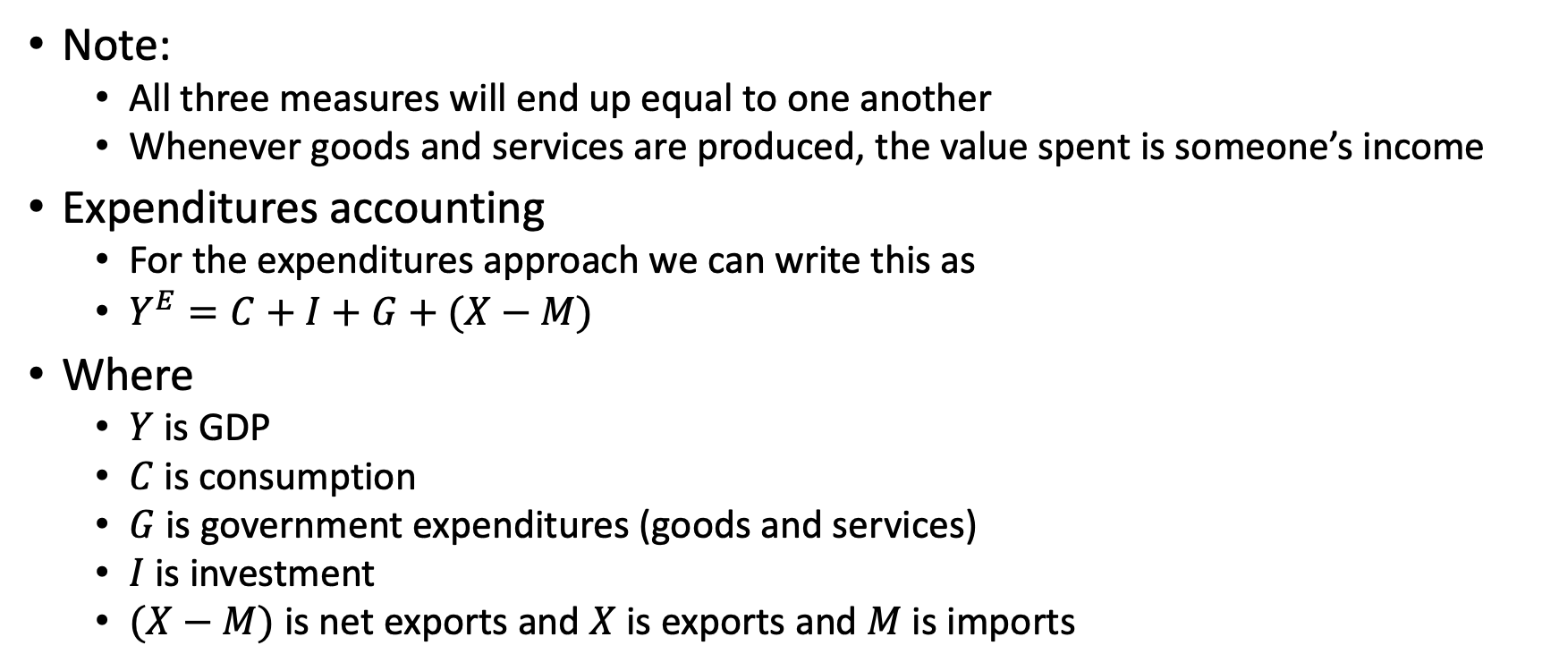
GDP Accounting
Note:
All three measures will end up equal to one another
Whenever goods and services are produced, the value spent is someone’s income
Expenditures accounting
For the expenditures approach we can write this as
$Y^{E}=C+I+G+(X−M)$
Where
$Y$ is GDP
$C$ is consumption
$G$ is government expenditures (goods and services)
$I$ is investment
$(X−M)$ is net exports and $X$ is exports and $M$ is imports

Slide 9
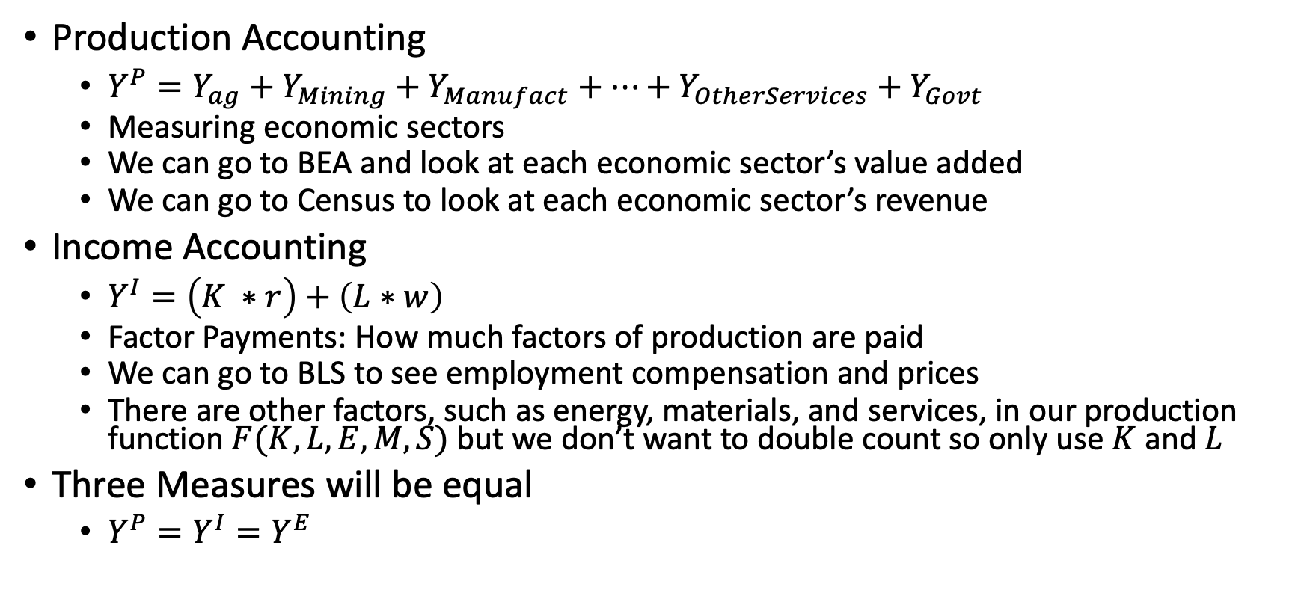
GDP Accounting
Production Accounting
$Y^{P}=Y_{ag}+Y_{Mining}+Y_{Manufact}+…+Y_{OtherServices}+Y_{Govt}$
Measuring economic sectors
We can go to BEA and look at each economic sector’s value added
We can go to Census to look at each economic sector’s revenue
Income Accounting
$Y^{I}=\left(K ∗r\right)+\left(L∗w\right)$
Factor Payments: How much factors of production are paid
We can go to BLS to see employment compensation and prices
There are other factors, such as energy, materials, and services, in our production function $F(K,L,E,M,S)$ but we don’t want to double count so only use $K$ and $L$
Three Measures will be equal
$Y^{P}=Y^{I}=Y^{E}$

Slide 10
U.S. GDP in 2017 (BEA)
Production (in billions) |  | Income |  | Expenditures
Agriculture (11) | 169 | Employee Comp | 10,421 | Consumption | 13,321
Mining (21) | 269 | Corporate Profits | 1,807 | Investment | 3,368
Utilities (22) | 308 | Proprietor’s Income | 1,501 | Government | 3,374
Construction (23 | 781 | Rental Income | 730 | Exports | 2,350
Manufacturing (31-33) | 2,180 | Depreciation | 3,116 | Imports | -2,929
Wholesale & Retail (42, 44-45) | 2,261 | Interest Income | 768
Transportation (48-49) | 609 | Taxes | 1,286
Information and Media (51) | 1,051 | Statistical Discrep. | -143
Finance and Insurance (52) | 1,466
Real Estate (53) | 2,591
Professional Services (54-55) | 2,426
Educ & Health Care (61-62) | 1,700
Arts & Entertainment (71-72) | 805
Other Services (81) | 416
Government (92) | 2,454
Total | 19,485 | Total | 19,485 | Total | 19,485

Slide 11
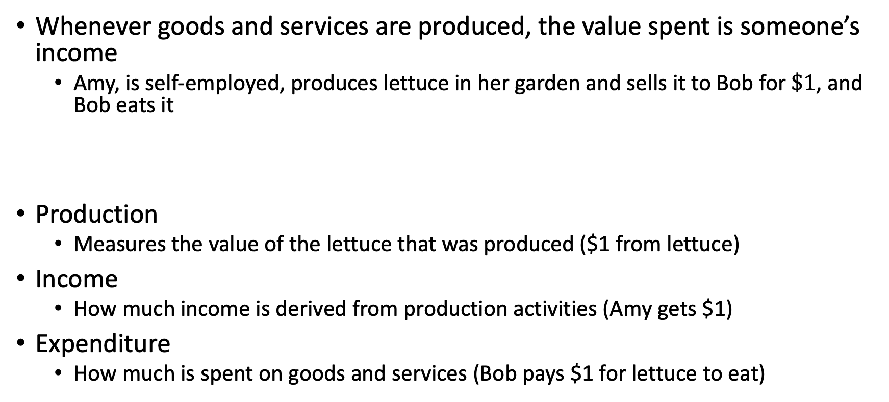
Value Added
Whenever goods and services are produced, the value spent is someone’s income
Amy, is self-employed, produces lettuce in her garden and sells it to Bob for $\$1$, and Bob eats it
Production
Measures the value of the lettuce that was produced ($1 from lettuce)
Income
How much income is derived from production activities (Amy gets $1)
Expenditure
How much is spent on goods and services (Bob pays $1 for lettuce to eat)
Production |  | Income |  | Expenditures
Agriculture (111) | $1 | Proprietor Income | $1 | Consumption | $1

Slide 12
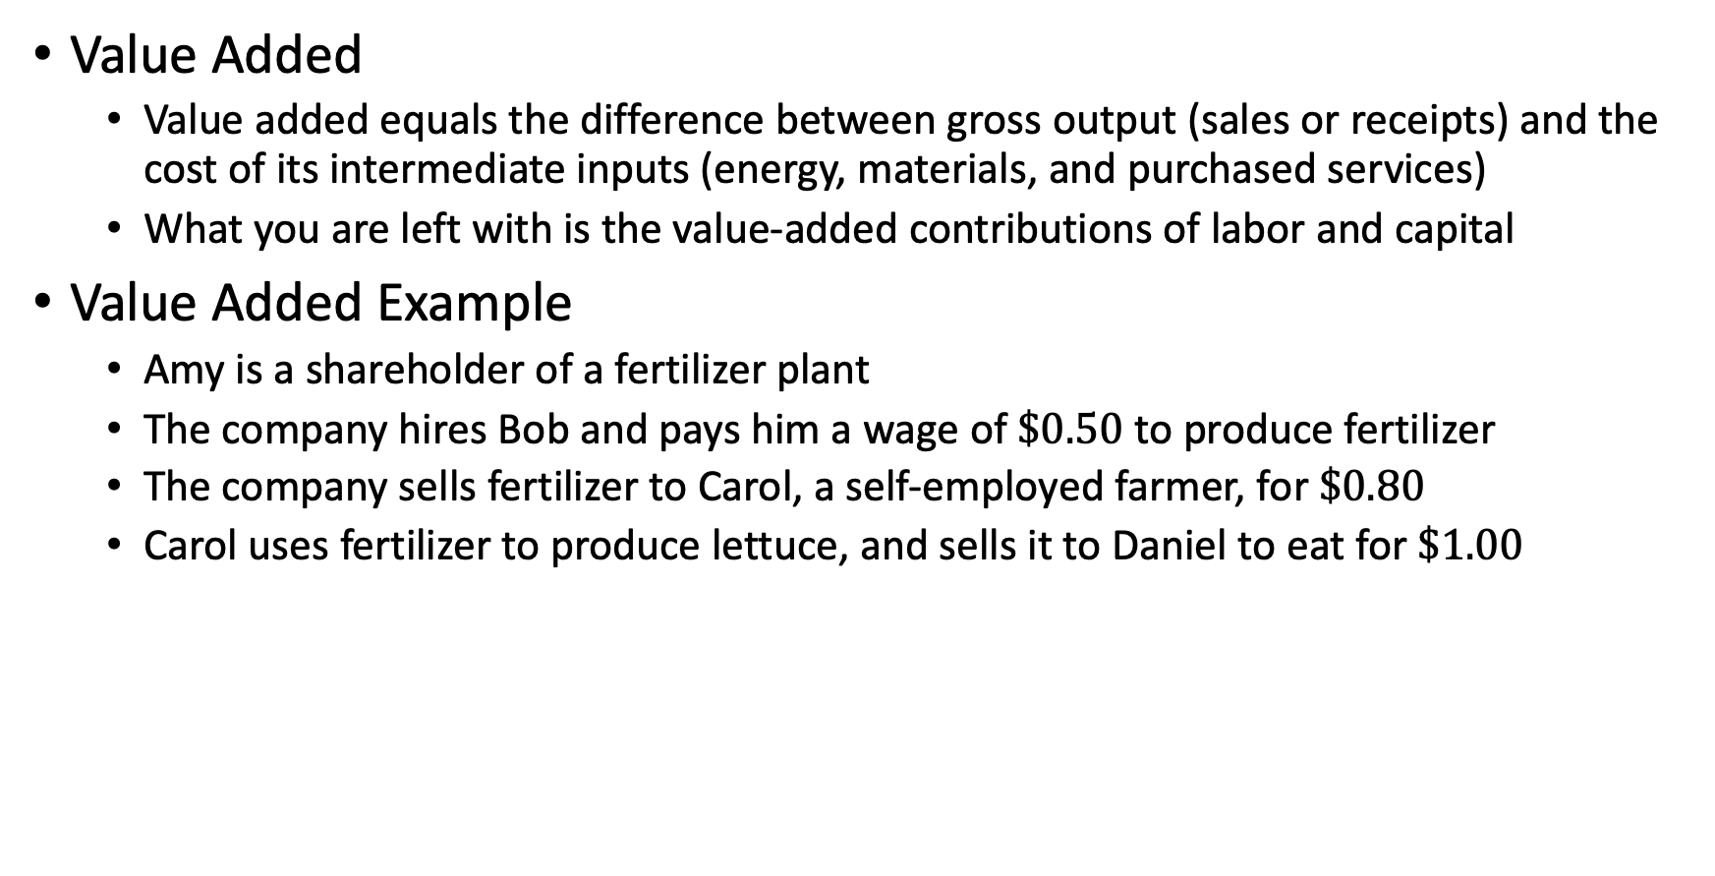
Value Added
Value Added
Value added equals the difference between gross output (sales or receipts) and the cost of its intermediate inputs (energy, materials, and purchased services)
What you are left with is the value-added contributions of labor and capital
Value Added Example
Amy is a shareholder of a fertilizer plant
The company hires Bob and pays him a wage of $\$0.50$ to produce fertilizer
The company sells fertilizer to Carol, a self-employed farmer, for $\$0.80$
Carol uses fertilizer to produce lettuce, and sells it to Daniel to eat for $\$1.00$
Production |  | Income |  | Expenditures
Manufacturing (325311) | 0.8 | Wages | 0.5 | Consumption | 1.0
Agriculture (111) | 0.2 | Profits | 0.3
 |  | Proprietor Income | 0.2
Total | 1.0 | Total | 1.0 | Total | 1.0

Slide 13
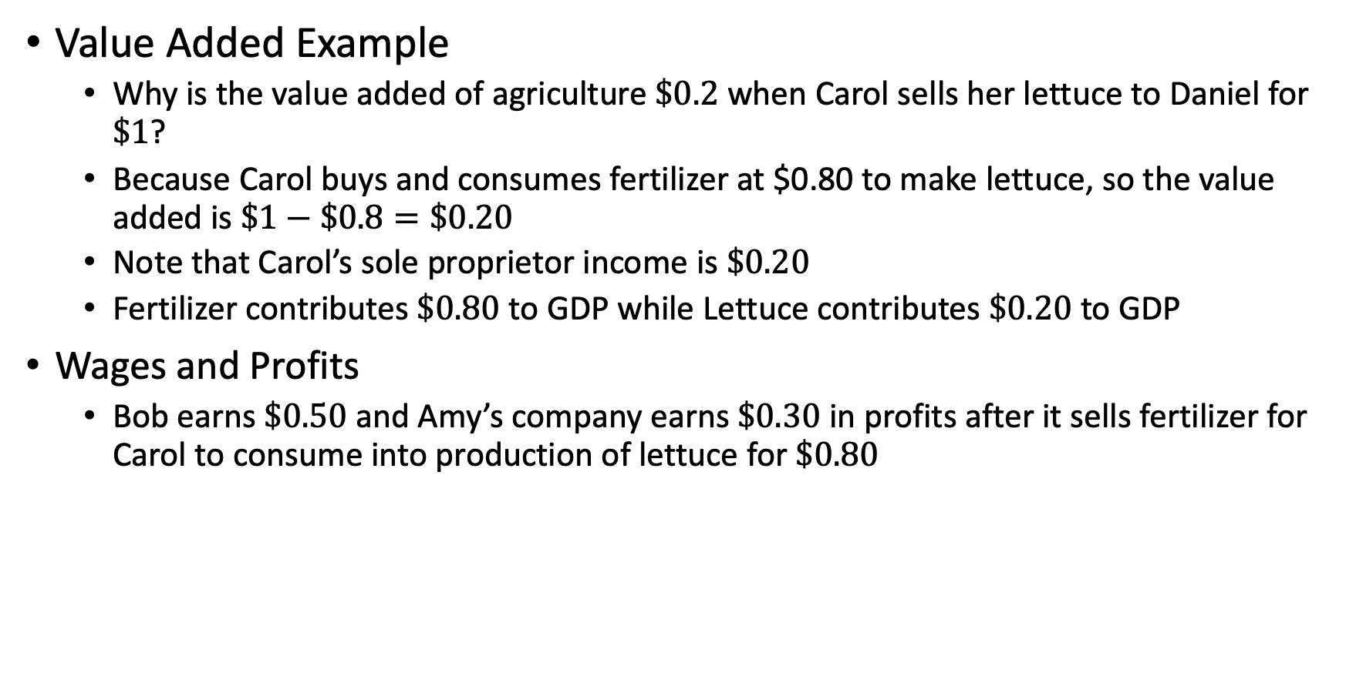
Value Added
Value Added Example
Why is the value added of agriculture $\$0.2$ when Carol sells her lettuce to Daniel for $\$1$?
Because Carol buys and consumes fertilizer at $0.80 to make lettuce, so the value added is $\$1−\$0.8=\$0.20$
Note that Carol’s sole proprietor income is $\$0.20$
Fertilizer contributes $\$0.80$ to GDP while Lettuce contributes $\$0.20$ to GDP
Wages and Profits
Bob earns $\$0.50$ and Amy’s company earns $\$0.30$ in profits after it sells fertilizer for Carol to consume into production of lettuce for $\$0.80$
Production |  | Income |  | Expenditures
Manufacturing (325311) | 0.8 | Wages | 0.5 | Consumption | 1.0
Agriculture (111) | 0.2 | Profits | 0.3
 |  | Proprietor Income | 0.2
Total | 1.0 | Total | 1.0 | Total | 1.0

Slide 14
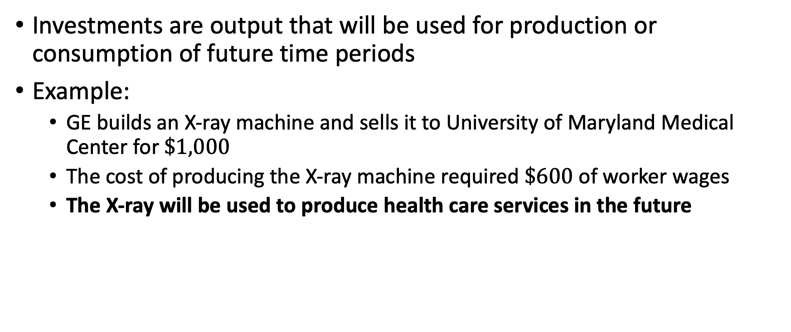
Investments
Investments are output that will be used for production or consumption of future time periods
Example:
GE builds an X-ray machine and sells it to University of Maryland Medical Center for $\$1,000$
The cost of producing the X-ray machine required $\$600$ of worker wages
The X-ray will be used to produce health care services in the future
Production |  | Income |  | Expenditure
Manufacturing (3345) | $1,000 | Wages | $600 | Investment | $1,000
 |  | Corporate Profits | $400
Total | $1,000 | Total | $1,000 | Total | $1,000

Slide 15
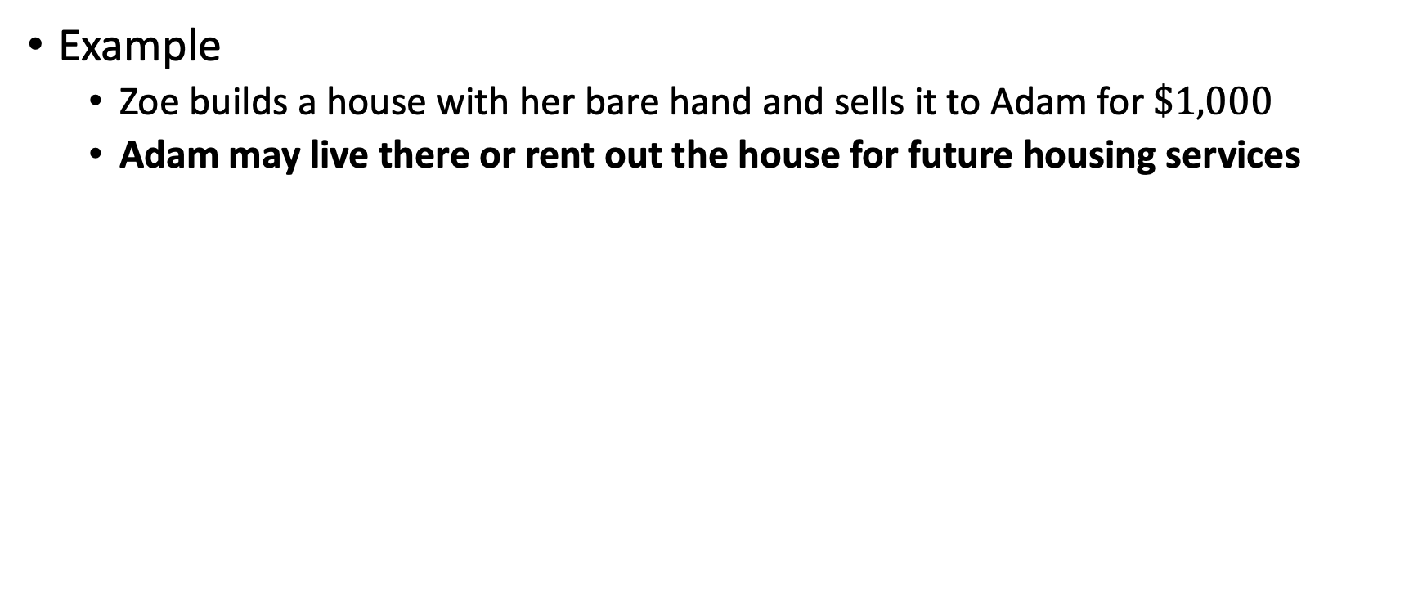
Investments
Example
Zoe builds a house with her bare hand and sells it to Adam for $\$1,000$
Adam may live there or rent out the house for future housing services
Production |  | Income |  | Expenditures
Construction (2361) | $1,000 | Proprietor Income | $1,000 | Investment | $1,000

Slide 16
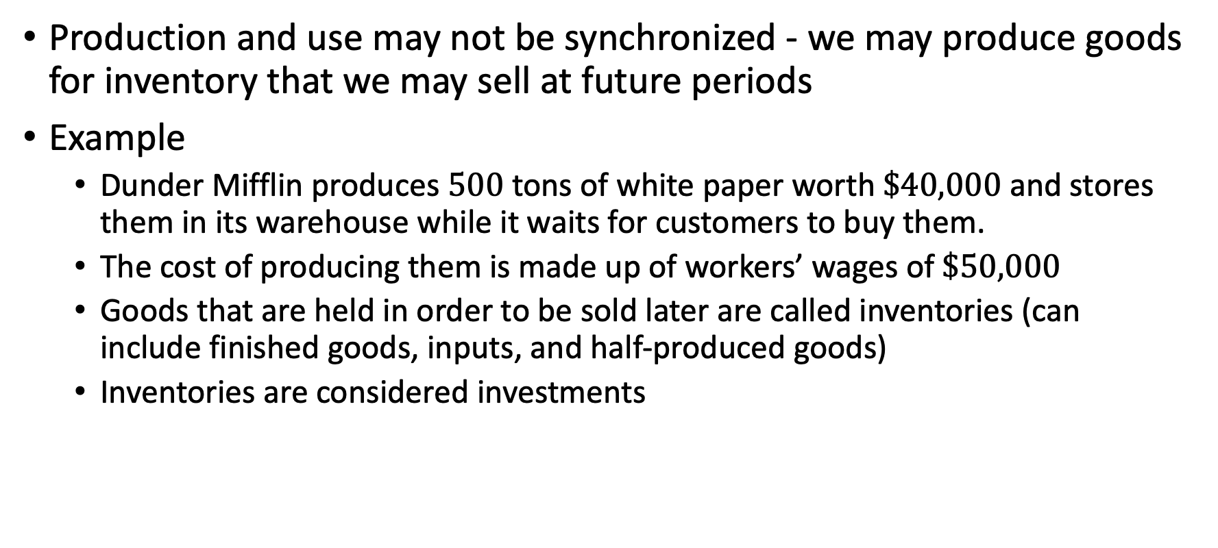
Investments (note to self – look at ASM)
Production and use may not be synchronized - we may produce goods for inventory that we may sell at future periods
Example
Dunder Mifflin produces $500$ tons of white paper worth $\$40,000$ and stores them in its warehouse while it waits for customers to buy them.
The cost of producing them is made up of workers’ wages of $\$50,000$
Goods that are held in order to be sold later are called inventories (can include finished goods, inputs, and half-produced goods)
Inventories are considered investments
Production |  | Income |  | Expenditure
Manufacturing (322120) | $40,000 | Wages | $50,000 | Investment | $40,000
 |  | Corporate profits | -$10,000
Total | $40,000 | Total | $40,000 | Total | $40,000

Slide 17
Investments
Warren Buffet ”invests” 100,000 in shares of General Motors, then Production, Income, and Expenditure are all 0
Investment is different in a macroeconomic sense compared to financial investment
There is a change in the ownership of the company but not an investment in a macroeconomic sense
Production |  | Income |  | Expenditures
 | 0 |  | 0 |  | 0

Slide 18
Durable Goods
The distinction between durable goods and investments might not always be clear
A house will be built for future “housing services”
A tv will provide “entertainment services” for the future
A refrigerator will produce “refrigerator services” in the future
What is the difference?
GDP treats these durable goods differently
Durable goods are counted for consumption at the time of purchase
Housing is treated differently since it is a large category, so long lived, and can be rented out
Consider durable good used for personal use vs production

Slide 19
Durable Goods vs Investments
Panasonic builds a TV and sells it to Bob for $500
Bob watches the TV he bought last year
Production |  | Income |  | Expenditure
Manufacturing (334310) | $500 | Corporate Profits | $500 | Consumption of Durables | $500
Production |  | Income |  | Expenditure
 | 0 |  | 0 |  | 0

Slide 20
Durables Goods vs Investments
A developer builds a house (at zero cost) and sells it to Claire for $100,000
Claire lives in the house she bought last year. In the rental market, a similar house would cost $7,000
Note:
BEA says that this practice keeps GDP invariant as to whether a house is owner-occupied or rented.
A service is assumed to flow from the house to the occupant over the economic life of the house which is the value of potential rental income
Production |  | Income |  | Expenditures
Construction (2361) | $100,000 | Corporate Profits | $100,000 | Residential Investment | $100,000
Production |  | Income |  | Expenditure
Housing Services (5311) | $7,000 | Imputed owner-occupied income | $7,000 | Consumption | $7,000

Slide 21
Foreign Activity
GDP includes everything produced within the country, whether or not it is used by its residents or nonresidents
We include goods produced domestically but consumed non-domestically
We include exports in GDP
Goods produced non-domestically but consumed domestically (imports) are not counted toward GDP
We deduct imports from GDP

Slide 22
Foreign Activity
Example
A car manufacturer buys $10 in components from Japan, but uses half of those components in the domestic production of a car
Andy buys the car from the car manufacturer for $20
There are no other production costs for the car
It stores the rest of its components for inventory
Amy, self-employed, produces lettuce and exports it to Franz for $2
Production |  | Income |  | Expenditure
Manufacturing (3361) | $15 | Corporate Profits | $15 | Consumption | 20
Agriculture (111) | $2 | Proprietor Income | $2 | Investment | 5
 |  |  |  | Exports | 2
 |  |  |  | Imports | -10
Total | $17 | Total | $17 | Total | $17

Slide 23
Government Activity
The government is a major producer of goods and services
The services may be provided directly so there is no price, but we need to count them into GDP
Example
Ms. Jody teaches Kindergarten in Howard County and earn $85,000
Jack collects his $20,000 pension from Social Security (just a transfer)
Production |  | Income |  | Expenditures
Elementary Education (6111) | 85,000 | Wages | 85,000 | Government | 85,000
Production |  | Income |  | Expenditures
 | 0 |  | 0 |  | 0

Slide 24
Government Activity
Example
The city of Towson hires the Baltimore Symphony Orchestra to play a free concert at a venue in Towson, and four people attend the concert
The musicians are paid $65,000 and rent out the venue costs $20,000
A new rail tunnel under Baltimore to replace the Baltimore and Potomac Tunnel costs 1 billion dollars, and only labor builds it
This is government expenditures and not investments (but there is a govt investment)
Production |  | Income |  | Expenditure
Arts & Entertainment (71) | 65,000 | Wages | 65,000 | Government | 85,000
Lessors of Real Estate (531) | 20,000 | Rental Income | 20,000
Total | 85,000 | Total |  | Total | 85,000
Production |  | Income |  | Expenditure
Construction (237990) | 1 billion | Wages | 1 billion | Government | 1 billion

Slide 25
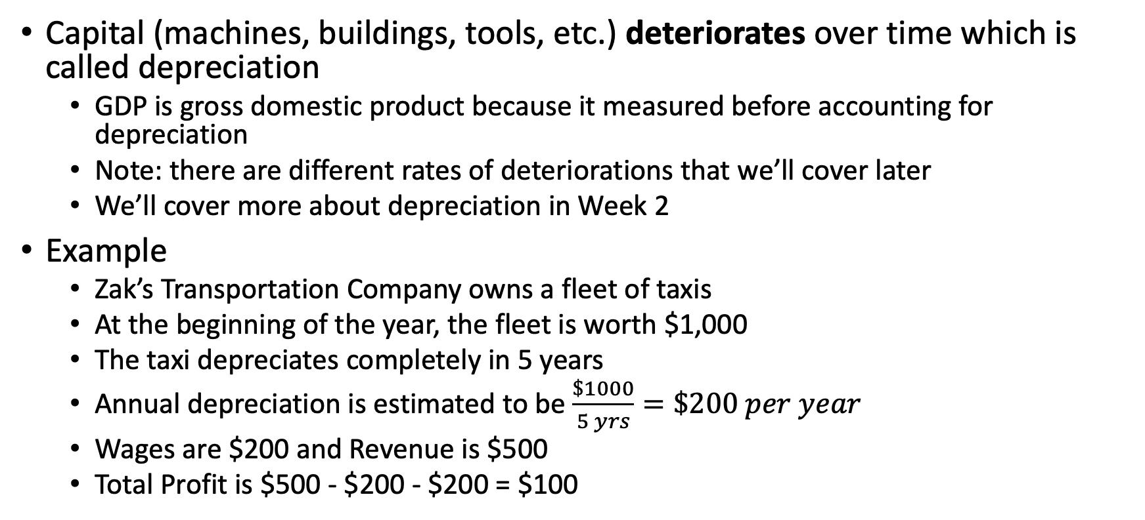
Depreciation
Capital (machines, buildings, tools, etc.) deteriorates over time which is called depreciation
GDP is gross domestic product because it measured before accounting for depreciation
Note: there are different rates of deteriorations that we’ll cover later
We’ll cover more about depreciation in Week 2
Example
Zak’s Transportation Company owns a fleet of taxis
At the beginning of the year, the fleet is worth $1,000
The taxi depreciates completely in 5 years
Annual depreciation is estimated to be $\frac{\$1000}{5 yrs}=\$200 per year$
Wages are $200 and Revenue is $500
Total Profit is $500 - $200 - $200 = $100

Slide 26
Depreciation
Taxi Example
When the company computes profits it knows its fleet has lost value over the year, so it subtracts depreciation
We need a before-depreciation measure, so we add depreciation back in
Our income measure needs to be consistent with our production measure
Production |  | Income |  | Expenditures
Taxi Service (485310) | $500 | Corporate Profits |  | Consumption | $500
 |  | Revenue | 500
 |  | Wages Paid | -200
 |  | Depreciation | -200
 |  | Total Profit | 100
 |  | Wages Received | 200
 |  | Depreciation | 200
Total | 500 | Total | 500 | Total | 500

Slide 27
Non-Market Activities
Non-market activities are usually not included in GDP
An exception is housing services and imputed owner-occupied income
We usually only measure an activity if it is sold on the market
Examples
Mary mows Andy’s lawn for $25. Andy takes care of Mary’s kids for $25
Andy mows his own lawn. Mary takes care of her own kids.
Production |  | Income |  | Expenditures
Gardening (561730) | $25 | Proprietor Income | $50 | Consumption | $50
Babysitting (624410) | $25
Total | $50 | Total | $50 | Total | $50
Production |  | Income |  | Expenditures
 | 0 |  | 0 |  | 0

Slide 28
GDP Comparisons

Slide 29
Making Comparisons of GDP
Two ways to compare GDP
Compare GDP across countries (at a point in time or across time)
Compare GDP within a country over time
Problem
We we measure GDP in the US, it is measured in US Dollars
The amount of goods and services you get for one dollar is not the same across countries (purchasing parity) or across time (inflation)
Nominal GDP
The total value of goods and services provided valued in units at time of production
Real GDP
The total value of goods and services produced, valued in units that are comparable across time, such as 2019 dollars; we deflate our measures to compare 2023 to 2019

Slide 30
Real GDP
There are three ways we can calculate Real GDP
Base year prices
Final year prices
Chained prices
What if we don’t use deflators?
Note
Output did not change, but prices grew; there was no growth
2017 |  | 2018
Manufacturing (50 balls, $10 each) | $500 | Manufacturing (50 balls, $20 each) | $1,000
Education (10 teachers, $100 each) | $1,000 | Education (10 teachers, $200 each) | $2,000
Total (2017 dollars) | $1,500 | Total (2018 dollars) | $3,000

Slide 31
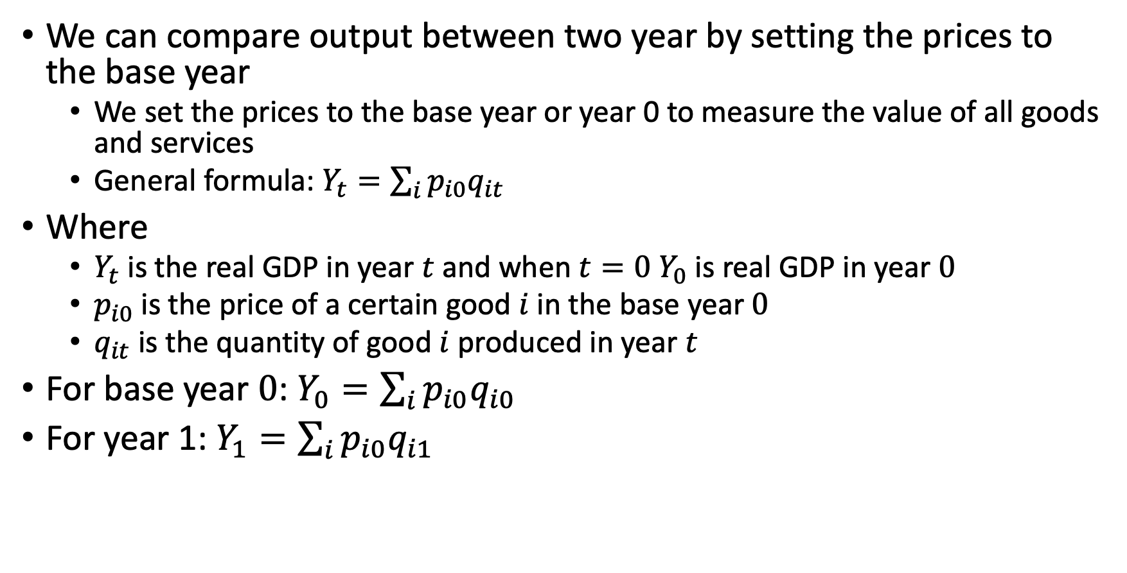
Real GDP Base Year in Prices
We can compare output between two year by setting the prices to the base year
We set the prices to the base year or year 0 to measure the value of all goods and services
General formula: $Y_{t}=\sum_{i}{p_{i0}q_{it}}$
Where
$Y_{t}$ is the real GDP in year $t$ and when $t=0$ $Y_{0}$ is real GDP in year $0$
$p_{i0}$ is the price of a certain good $i$ in the base year $0$
$q_{it}$ is the quantity of good $i$ produced in year $t$
For base year $0$: $Y_{0}=\sum_{i}{p_{i0}q_{i0}}$
For year 1: $Y_{1}=\sum_{i}{p_{i0}q_{i1}}$

Slide 32
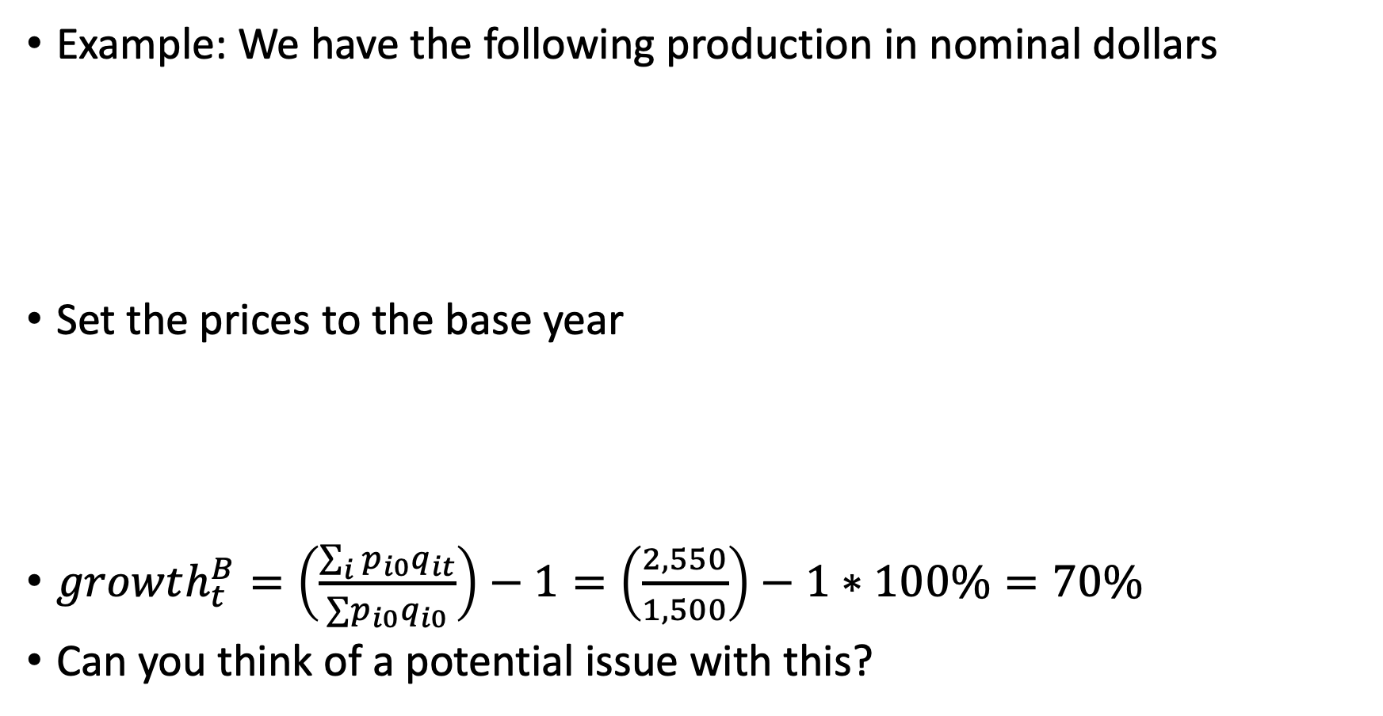
Real GDP in Base Year Prices
Example: We have the following production in nominal dollars
Set the prices to the base year
$growth_{t}^{B}=\left(\frac{\sum_{i}{p_{i0}q_{it}}}{∑p_{i0}q_{i0}}\right)−1=\left(\frac{2,550}{1,500}\right)−1∗100\%=70\%$
Can you think of a potential issue with this?
Production (2017) |  | Production (2018)
Agriculture (10 tons of wheat, $50 each) | 500 | Agriculture (11 tons of wheat, $60 each) | 660
Manufacturing (1 computer, $1,000) | 1,000 | Manufacturing (2 computers, $600 each) | 1,200
Total (2017 dollars) | 1,500 | Total (2018 dollars) | 1,860
Production (2017) |  | Production (2018) in 2017 dollars
Agriculture (10 tons of wheat, $50 each) | 500 | Agriculture (11 tons of wheat, $50 each) | 550
Manufacturing (1 computer, $1,000) | 1,000 | Manufacturing (2 computers, $1,000 each) | 2,000
Total (2017 dollars) | 1,500 | Total (2018 dollars) | 2,550

Slide 33
Real GDP in Base Year Prices
Example: We have the following production in nominal dollars
Set the prices to the base year
BLS makes quality adjustments to the PPI & CPI to look at only price changes
Production (2017) in 2017 dollars |  | Production (2018) in 2018 dollars
Agriculture (10 tons of wheat, $50 each) | 500 | Agriculture (11 tons of wheat, $60 each) | 660
Manufacturing (1 computer, $1,000) | 1,000 | Manufacturing (2 computers, $600 each) | 1,200
Total (2017 dollars) | 1,500 | Total (2018 dollars) | 1,860
Production (2017) in 2017 dollars |  | Production (2018) in 2017 dollars
Agriculture (10 tons of wheat, $50 each) | 500 | Agriculture (11 tons of wheat, $50 each) | 550
Manufacturing (1 computer, $1,000) | 1,000 | Manufacturing (2 computers, $1,000 each) | 2,000
Total (2017 dollars) | 1,500 | Total (2018 dollars) | 2,550

Slide 34
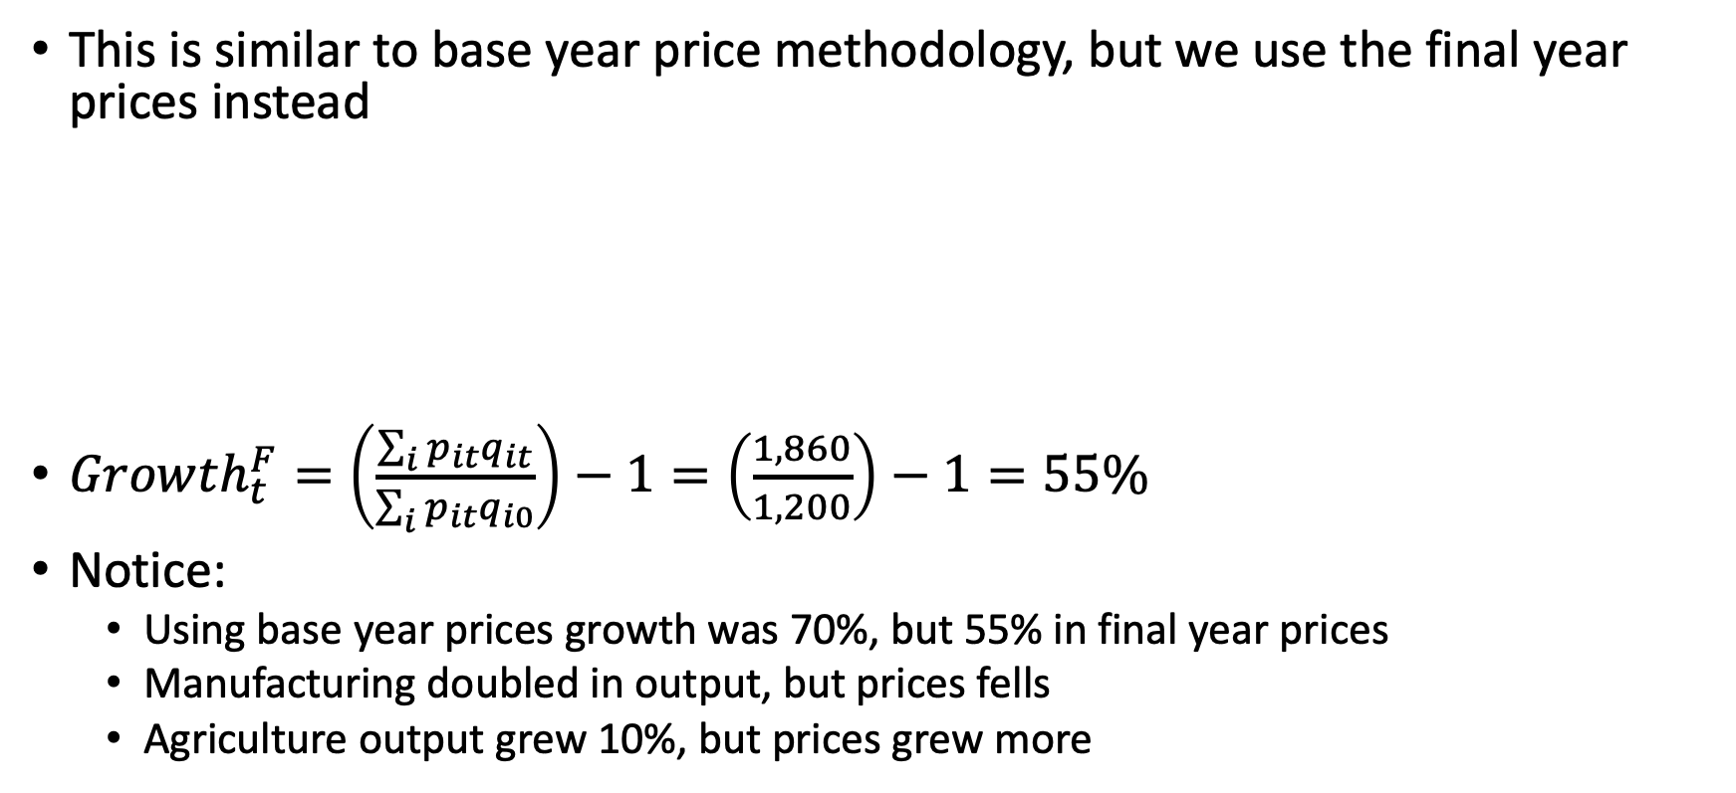
Real GDP in Final Year Prices
This is similar to base year price methodology, but we use the final year prices instead
$Growth_{t}^{F}=\left(\frac{\sum_{i}{p_{it}q_{it}}}{\sum_{i}{p_{it}q_{i0}}}\right)−1=\left(\frac{1,860}{1,200}\right)−1=55\%$
Notice:
Using base year prices growth was 70%, but 55% in final year prices
Manufacturing doubled in output, but prices fells
Agriculture output grew 10%, but prices grew more
Production (2017) in 2018 dollars |  | Production (2018) in 2018 dollars
Agriculture (10 tons of wheat, $60 each) | 600 | Agriculture (11 tons of wheat, $60 each) | 660
Manufacturing (1 computer, $600) | 600 | Manufacturing (2 computers, $600 each) | 1,200
Total (2017 dollars) | 1,200 | Total (2018 dollars) | 1,860

Slide 35
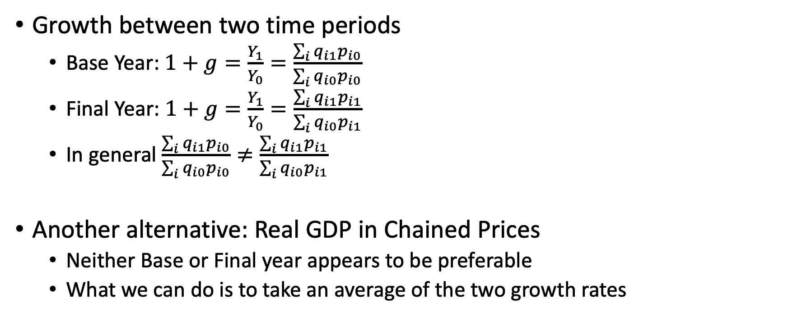
Real GDP in Chained Prices
Growth between two time periods
Base Year: $1+g=\frac{Y_{1}}{Y_{0}}=\frac{\sum_{i}{q_{i1}p_{i0}}}{\sum_{i}{q_{i0}p_{i0}}}$
Final Year: $1+g=\frac{Y_{1}}{Y_{0}}=\frac{\sum_{i}{q_{i1}p_{i1}}}{\sum_{i}{q_{i0}p_{i1}}}$
In general $\frac{\sum_{i}{q_{i1}p_{i0}}}{\sum_{i}{q_{i0}p_{i0}}}≠\frac{\sum_{i}{q_{i1}p_{i1}}}{\sum_{i}{q_{i0}p_{i1}}}$
Another alternative: Real GDP in Chained Prices
Neither Base or Final year appears to be preferable
What we can do is to take an average of the two growth rates

Slide 36
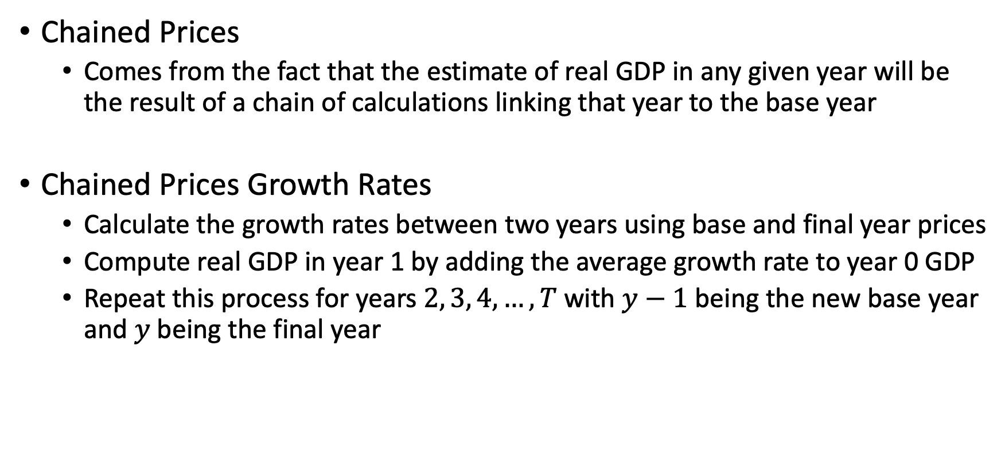
Real GDP in Chained Prices
Chained Prices
Comes from the fact that the estimate of real GDP in any given year will be the result of a chain of calculations linking that year to the base year
Chained Prices Growth Rates
Calculate the growth rates between two years using base and final year prices
Compute real GDP in year 1 by adding the average growth rate to year 0 GDP
Repeat this process for years $2, 3, 4, …,T$ with $y−1$ being the new base year and $y$ being the final year

Slide 37
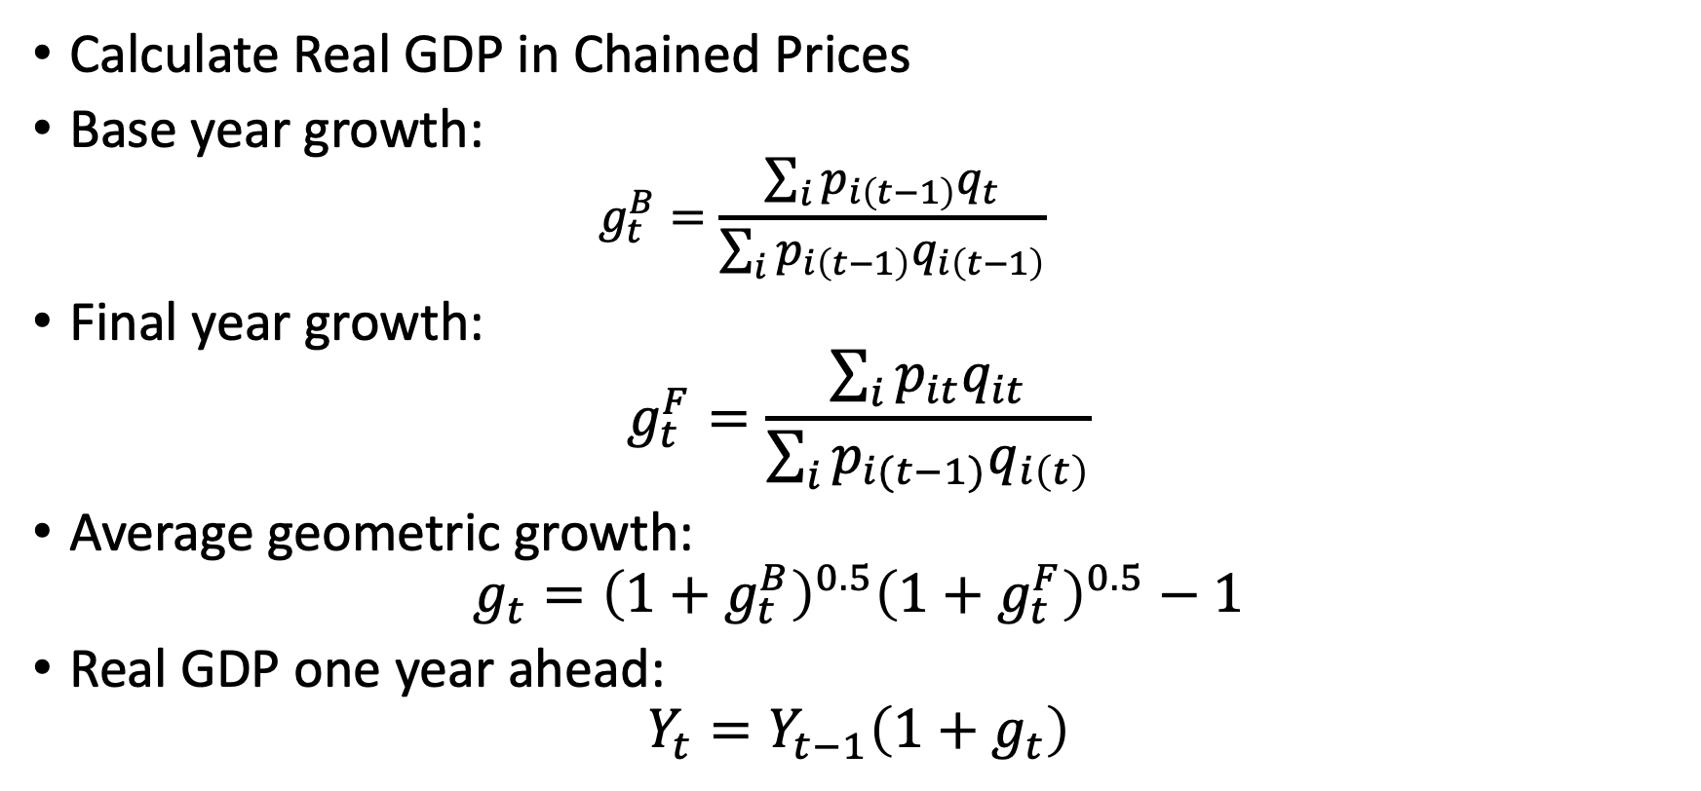
Real GDP in Chained Prices
Calculate Real GDP in Chained Prices
Base year growth:
$$g_{t}^{B}=\frac{\sum_{i}{p_{i\left(t−1\right)}q_{t}}}{\sum_{i}{p_{i\left(t−1\right)}q_{i\left(t−1\right)}}}$$
Final year growth:
$$g_{t}^{F}=\frac{\sum_{i}{p_{it}q_{it}}}{\sum_{i}{p_{i(t−1)}q_{i\left(t\right)}}}$$
Average geometric growth:
$$g_{t}={\left(1+g_{t}^{B}\right)}^{0.5}{\left(1+g_{t}^{F}\right)}^{0.5}−1$$
Real GDP one year ahead:
$$Y_{t}=Y_{t−1}\left(1+g_{t}\right)$$

Slide 38
GDP comparisons across countries
How can we make comparisons across countries when GDP is measured in the countries currency?
Market Exchange Rates
Purchasing Power Parity
Who produced more and who has a higher GDP per capita?
We cannot tell since production is in different units
 | United States (US Dollars) 2018 | Mexico (Pesos) 2018
GDP | 20.5 trillion dollars | 23.5 trillion pesos
Population | 327 million | 127 million
GDP Per Capita | $62,700 per person | $185,000 pesos per person

Slide 39
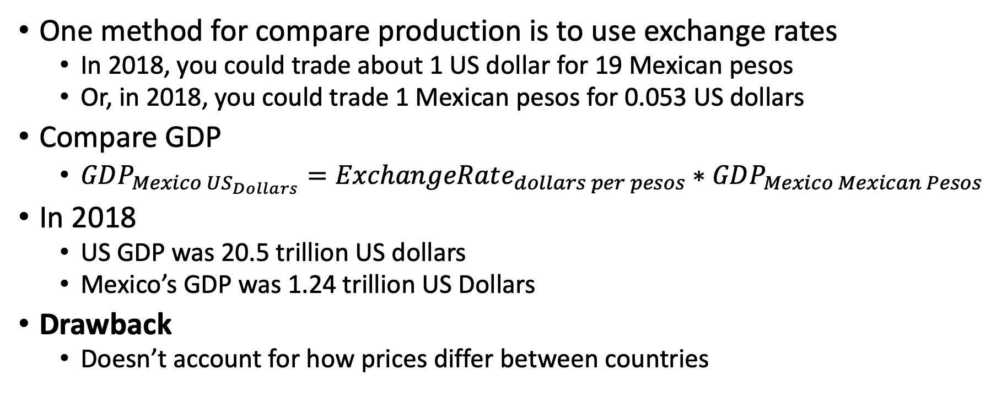
Exchange Rates
One method for compare production is to use exchange rates
In 2018, you could trade about 1 US dollar for 19 Mexican pesos
Or, in 2018, you could trade 1 Mexican pesos for 0.053 US dollars
Compare GDP
$GDP_{Mexico US_{Dollars}}=ExchangeRate_{dollars per pesos}∗GDP_{Mexico Mexican Pesos}$
In 2018
US GDP was 20.5 trillion US dollars
Mexico’s GDP was 1.24 trillion US Dollars
Drawback
Doesn’t account for how prices differ between countries

Slide 40
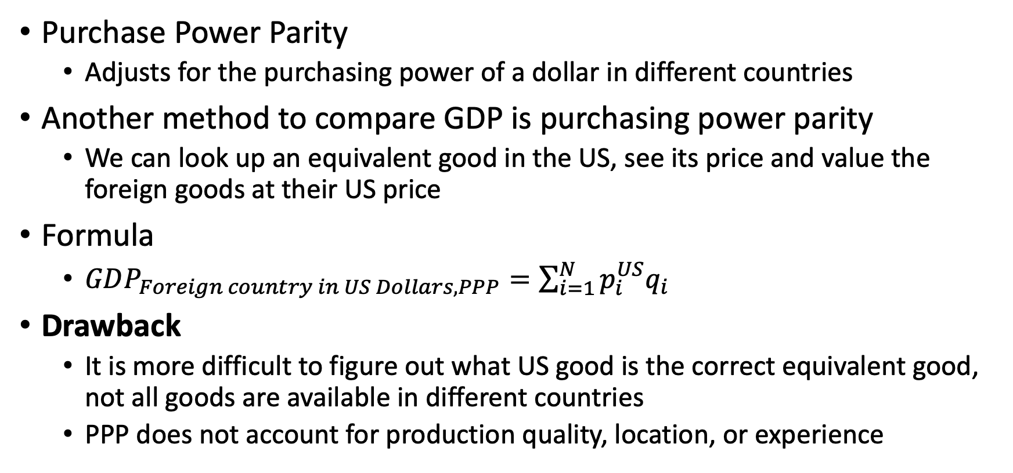
Purchasing Power Parity
Purchase Power Parity
Adjusts for the purchasing power of a dollar in different countries
Another method to compare GDP is purchasing power parity
We can look up an equivalent good in the US, see its price and value the foreign goods at their US price
Formula
$GDP_{Foreign country in US Dollars, PPP}=\sum_{i=1}^{N}{p_{i}^{US}q_{i}}$
Drawback
It is more difficult to figure out what US good is the correct equivalent good, not all goods are available in different countries
PPP does not account for production quality, location, or experience

Slide 41
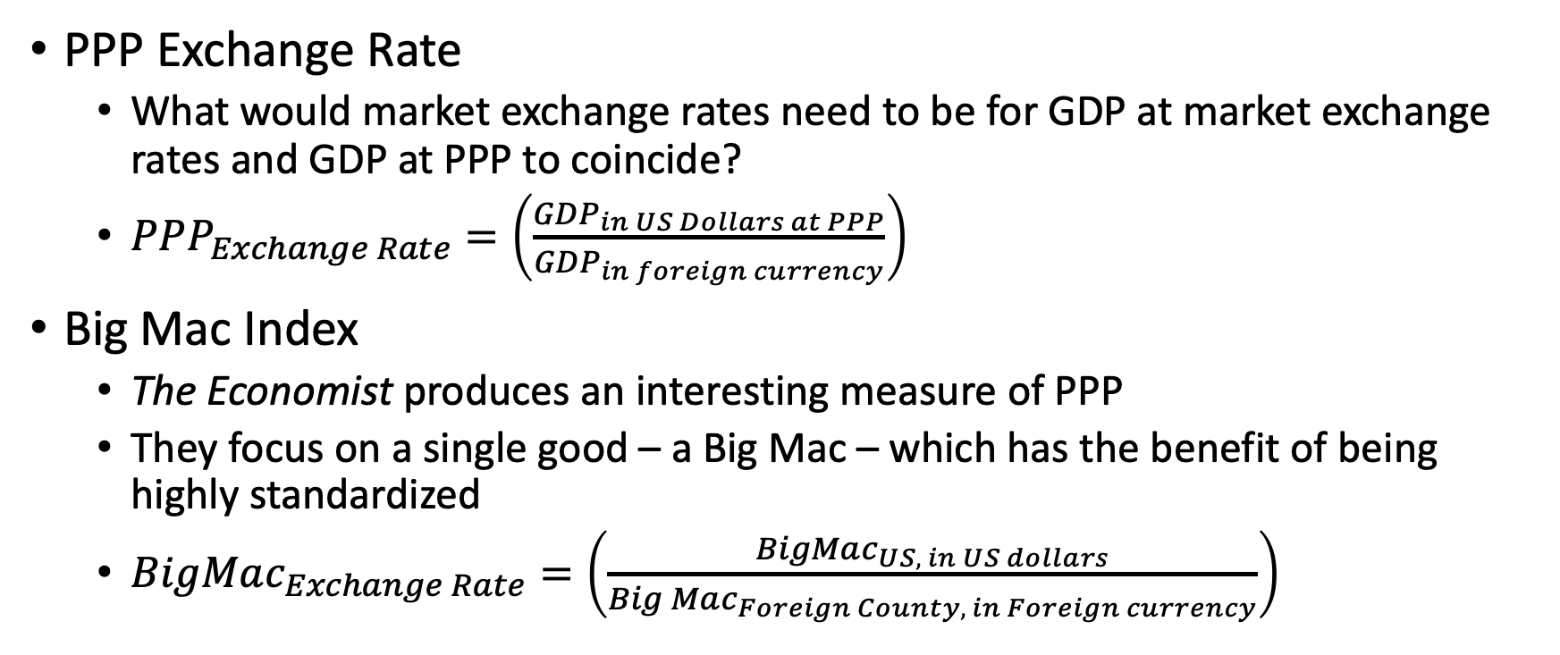
Purchasing Power Parity
PPP Exchange Rate
What would market exchange rates need to be for GDP at market exchange rates and GDP at PPP to coincide?
$PPP_{Exchange Rate}=\left(\frac{GDP_{in US Dollars at PPP}}{GDP_{in foreign currency}}\right)$
Big Mac Index
The Economist produces an interesting measure of PPP
They focus on a single good – a Big Mac – which has the benefit of being highly standardized
$BigMac_{Exchange Rate}=\left(\frac{BigMac_{US, in US dollars}}{Big Mac_{Foreign County, in Foreign currency}}\right)$

Slide 42
Beyond GDP
Kurlat Chapter 2

Slide 43
Beyond GDP
What does GDP tell us?
GDP measure how much output is produced (not consumption) in the market
GDP does not tell us directly about living standards
Other topics on well-being besides GDP
The Human Development Index
Living Standards
Consumption
Inequality and Risk Aversion
The Value of Leisure and Non-Market Activities

Slide 44
The Human Development Index
The Human Development Index (HDI)
Is a measures of per capita income, life expectancy, and expected years of education
Other factors are harder (or subjective) to measures such as quality of the arts
The contents of the HDI
The logic is to have a comparable number between 0 and 1
Life expectancy for the healthiest countries is 80 years old and least healthiest is 40 years old
Education expectancy is between 0 and 18 years of life
Income index is GNP( (which is close but different from GDP) per capita that ranges between 400 and 75,000 US dollar (PPP)
*Note: GNP measures the goods and services produced by citizens of a country where they live within the country or are expatriates; it does not count the economic activity of nonresidents within a country. GDP measures total goods and services produced within a country where by citizens or nonresidents, but does not count expatriate activity

Slide 45
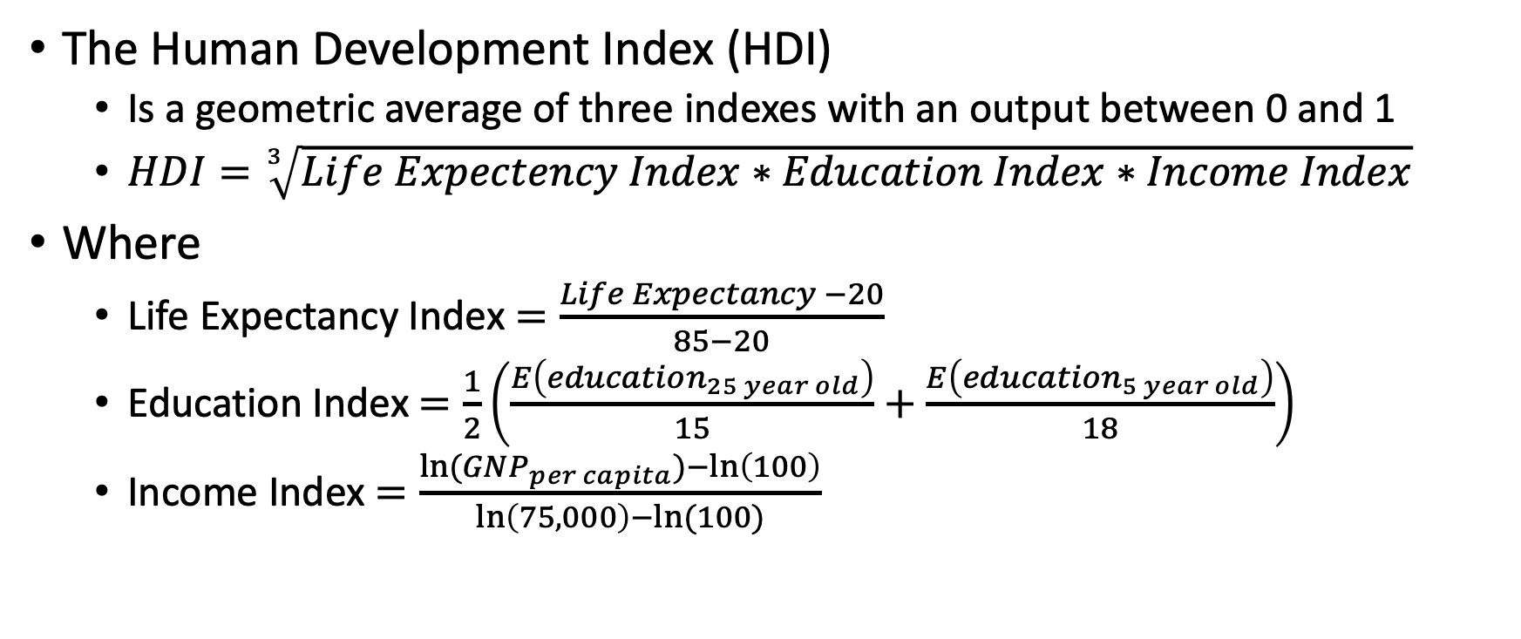
The Human Development Index
The Human Development Index (HDI)
Is a geometric average of three indexes with an output between 0 and 1
$HDI=\sqrt[3]{Life Expectency Index∗Education Index∗Income Index}$
Where
Life Expectancy Index $=\frac{Life Expectancy −20}{85−20}$
Education Index $=\frac{1}{2}\left(\frac{E\left(education_{25 year old}\right)}{15}+\frac{E\left(education_{5 year old}\right)}{18}\right)$
Income Index $=\frac{ln⁡(GNP_{per capita})−\ln\left(100\right)}{\ln\left(75,000\right)−ln⁡(100)}$

Slide 46

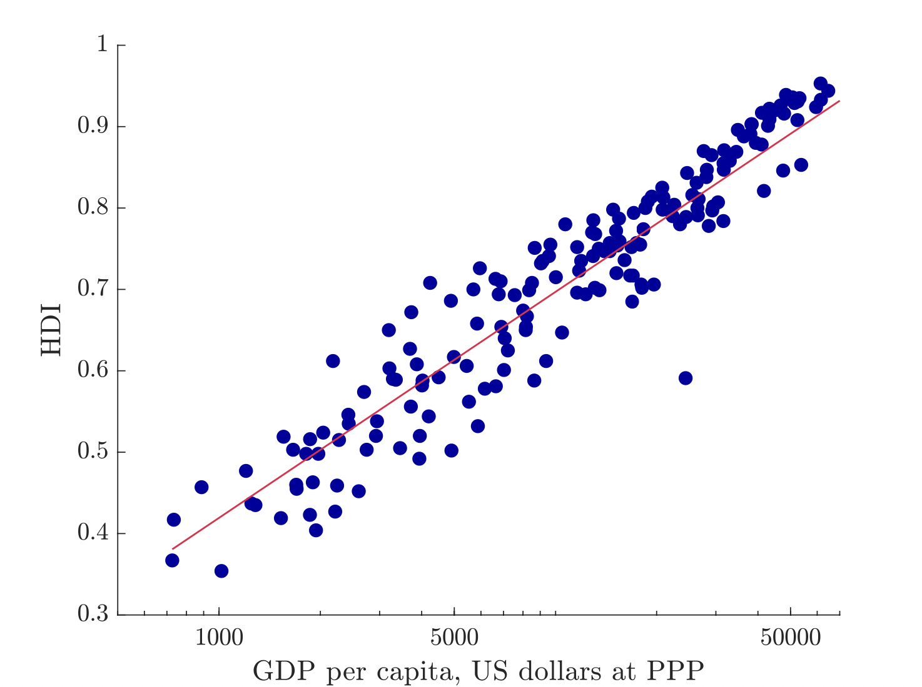
The Human Development Index
GDP per capita and HDI are highly correlated
Note: check the scales of the x-axis
Most high GDP per capita countries have high HDI with a few expectations

Slide 47
Beyond GDP
Jones and Klenow (2016) proposes a living standard measure (or well-being measure) that is similar in spirit to the HDI
Consumption (instead of production)
The value of leisure and non-market production
Life expectancy
Inequality
We go through a thought experiment
Where do we want to live between two countries
We are going to compare US to a fictional country called Utilia

Slide 48
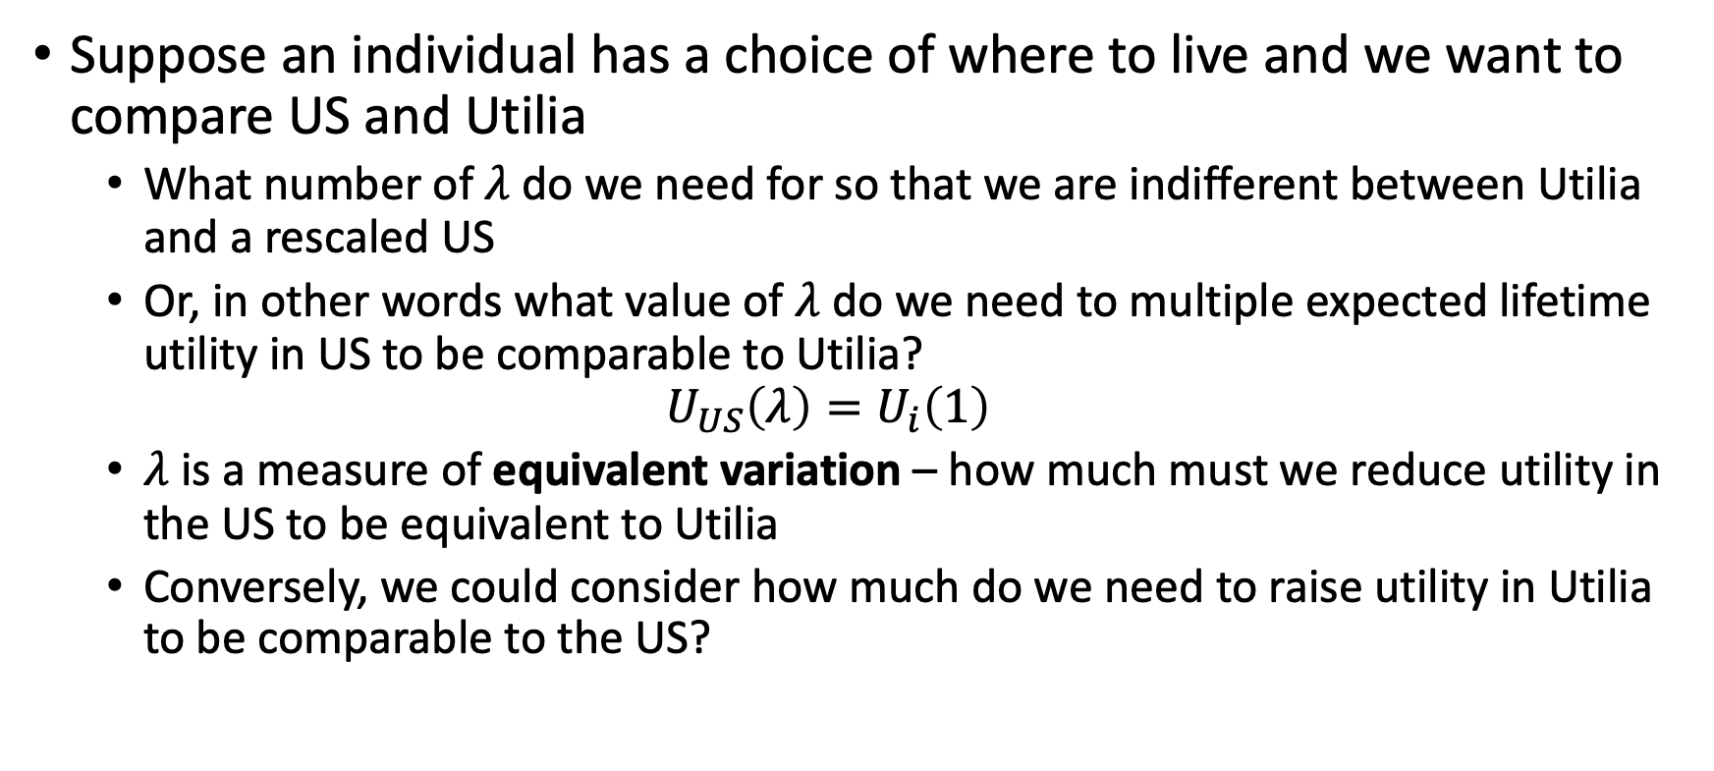
Beyond GDP
Suppose an individual has a choice of where to live and we want to compare US and Utilia
What number of $λ$ do we need for so that we are indifferent between Utilia and a rescaled US
Or, in other words what value of $λ$ do we need to multiple expected lifetime utility in US to be comparable to Utilia?
$$U_{US}\left(λ\right)=U_{i}\left(1\right)$$
$λ$ is a measure of equivalent variation – how much must we reduce utility in the US to be equivalent to Utilia
Conversely, we could consider how much do we need to raise utility in Utilia to be comparable to the US?

Slide 49
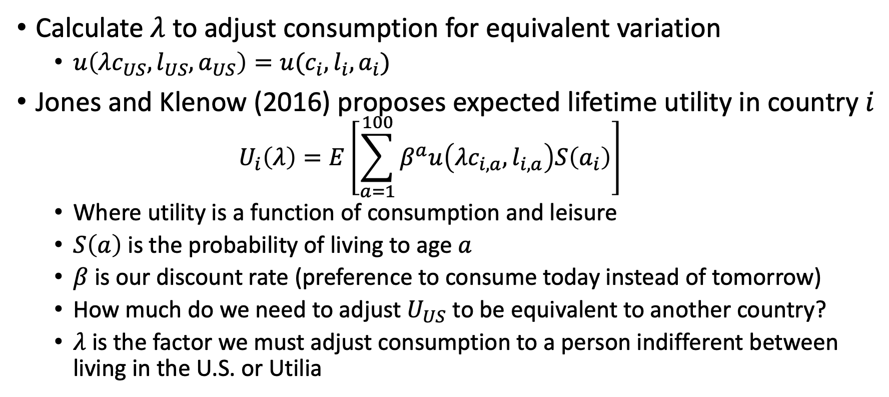
Beyond GDP
Calculate $λ$ to adjust consumption for equivalent variation
$u\left(λc_{US},l_{US},a_{US}\right)=u(c_{i},l_{i},a_{i})$
Jones and Klenow (2016) proposes expected lifetime utility in country $i$
$$U_{i}\left(λ\right)=E\left[\sum_{a=1}^{100}{β^{a}u\left(λc_{i,a},l_{i,a}\right)S\left(a_{i}\right)}\right]$$
Where utility is a function of consumption and leisure
$S\left(a\right)$ is the probability of living to age $a$
$β$ is our discount rate (preference to consume today instead of tomorrow)
How much do we need to adjust $U_{US}$ to be equivalent to another country?
$λ$ is the factor we must adjust consumption to a person indifferent between living in the U.S. or Utilia

Slide 50
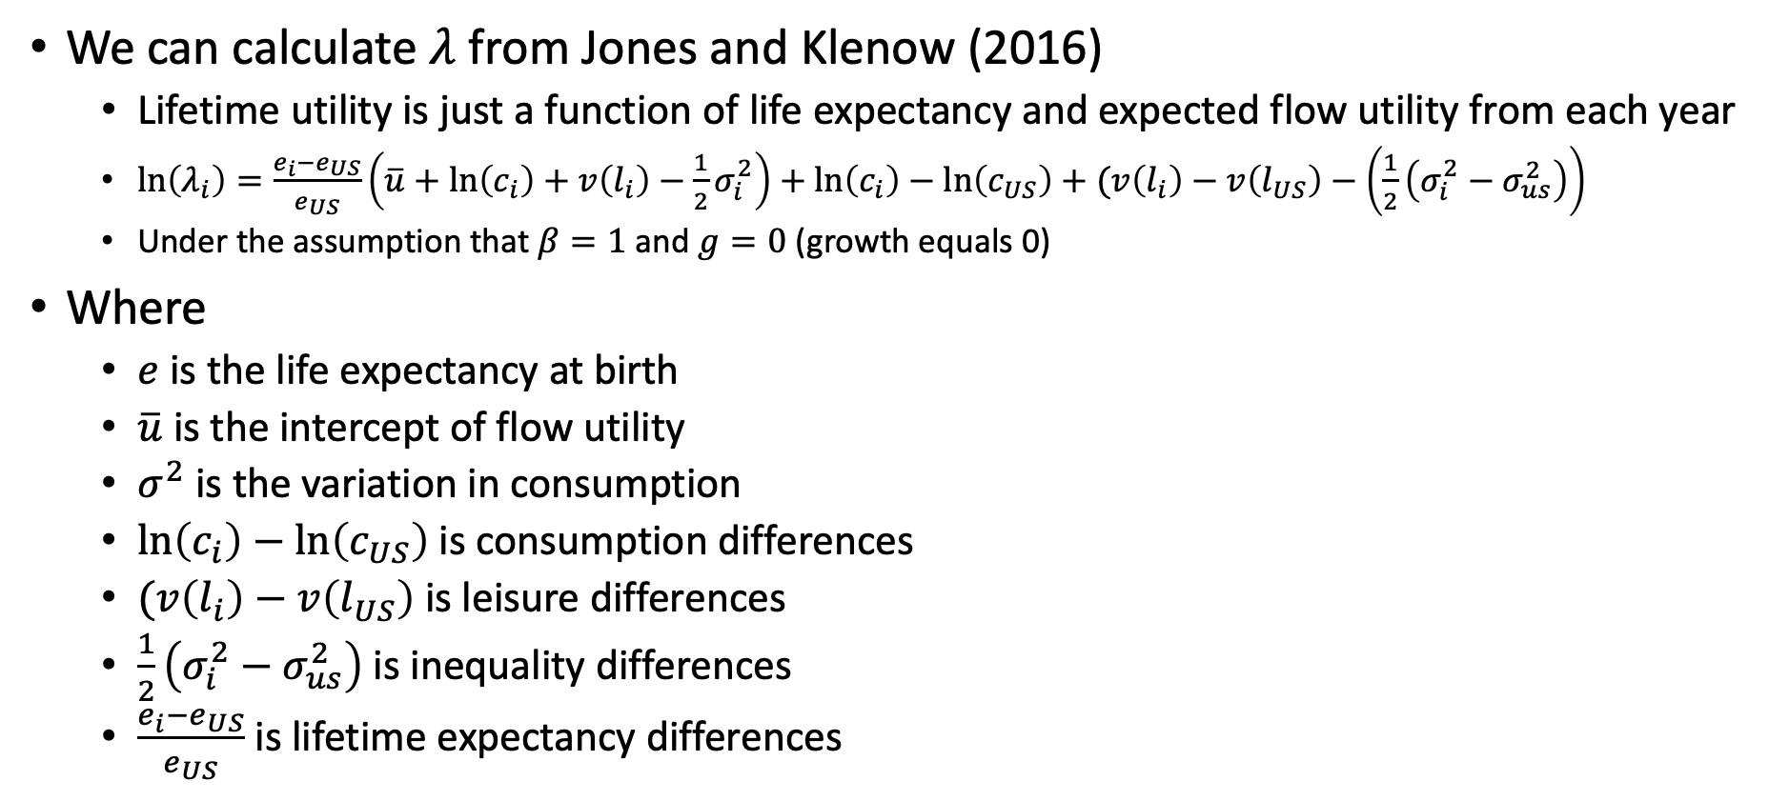
Beyond GDP
We can calculate $λ$ from Jones and Klenow (2016)
Lifetime utility is just a function of life expectancy and expected flow utility from each year
$\ln\left(λ_{i}\right)=\frac{e_{i}−e_{US}}{e_{US}}\left(\overline{u}+\ln\left(c_{i}\right)+v\left(l_{i}\right)−\frac{1}{2}σ_{i}^{2}\right)+\ln\left(c_{i}\right)−\ln\left(c_{US}\right)+(v\left(l_{i}\right)−v\left(l_{US}\right)−\left(\frac{1}{2}\left(σ_{i}^{2}−σ_{us}^{2}\right)\right)$
Under the assumption that $β=1$ and $g=0$ (growth equals 0)
Where
$e$ is the life expectancy at birth
$\overline{u}$ is the intercept of flow utility
$σ^{2}$ is the variation in consumption
$\ln\left(c_{i}\right)−\ln\left(c_{US}\right)$is consumption differences
$(v\left(l_{i}\right)−v\left(l_{US}\right)$ is leisure differences
$\frac{1}{2}\left(σ_{i}^{2}−σ_{us}^{2}\right)$ is inequality differences
$\frac{e_{i}−e_{US}}{e_{US}}$ is lifetime expectancy differences

Slide 51
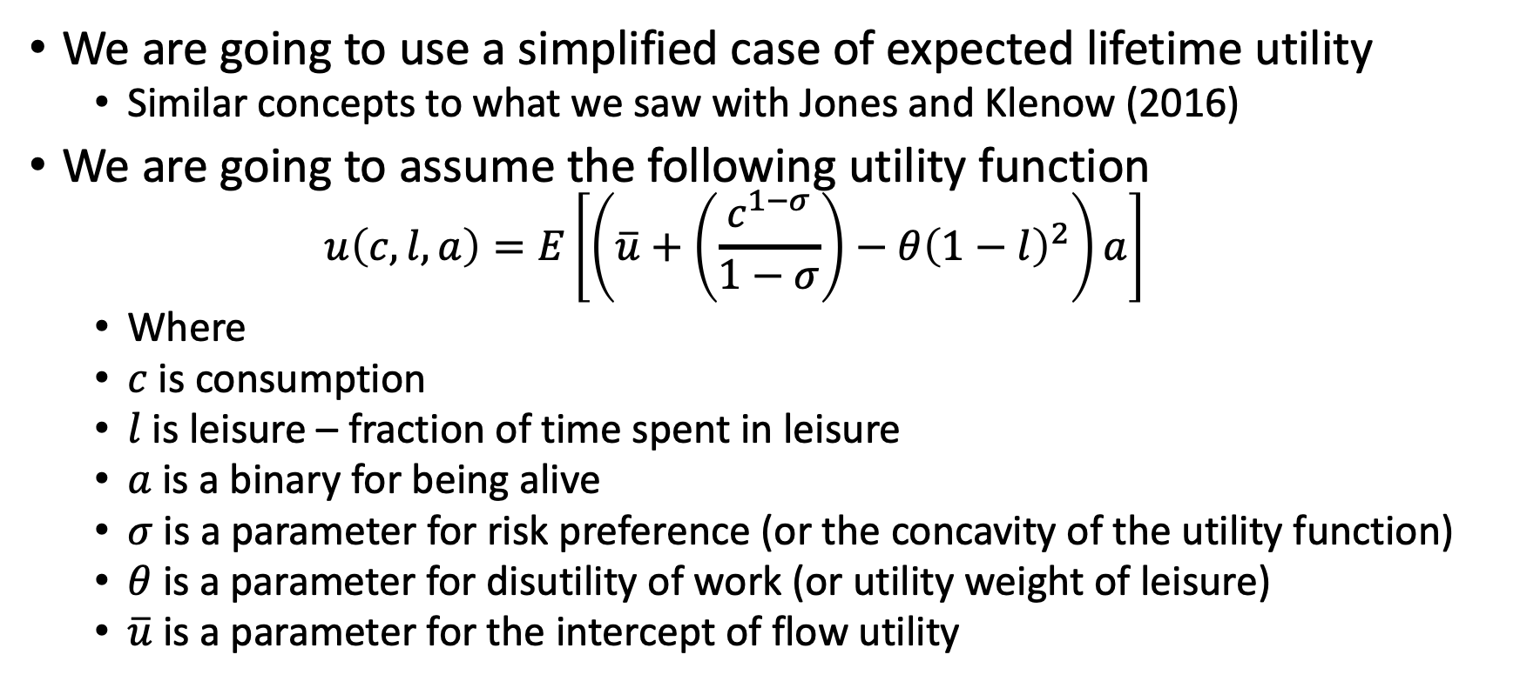
Beyond GDP
We are going to use a simplified case of expected lifetime utility
Similar concepts to what we saw with Jones and Klenow (2016)
We are going to assume the following utility function
$$u\left(c,l,a\right)=E\left[\left(\overline{u}+\left(\frac{c^{1−σ}}{1−σ}\right)−θ{\left(1−l\right)}^{2}\right)a\right]$$
Where
$c$ is consumption
$l$ is leisure – fraction of time spent in leisure
$a$ is a binary for being alive
$σ$ is a parameter for risk preference (or the concavity of the utility function)
$θ$ is a parameter for disutility of work (or utility weight of leisure)
$\overline{u}$ is a parameter for the intercept of flow utility

Slide 52
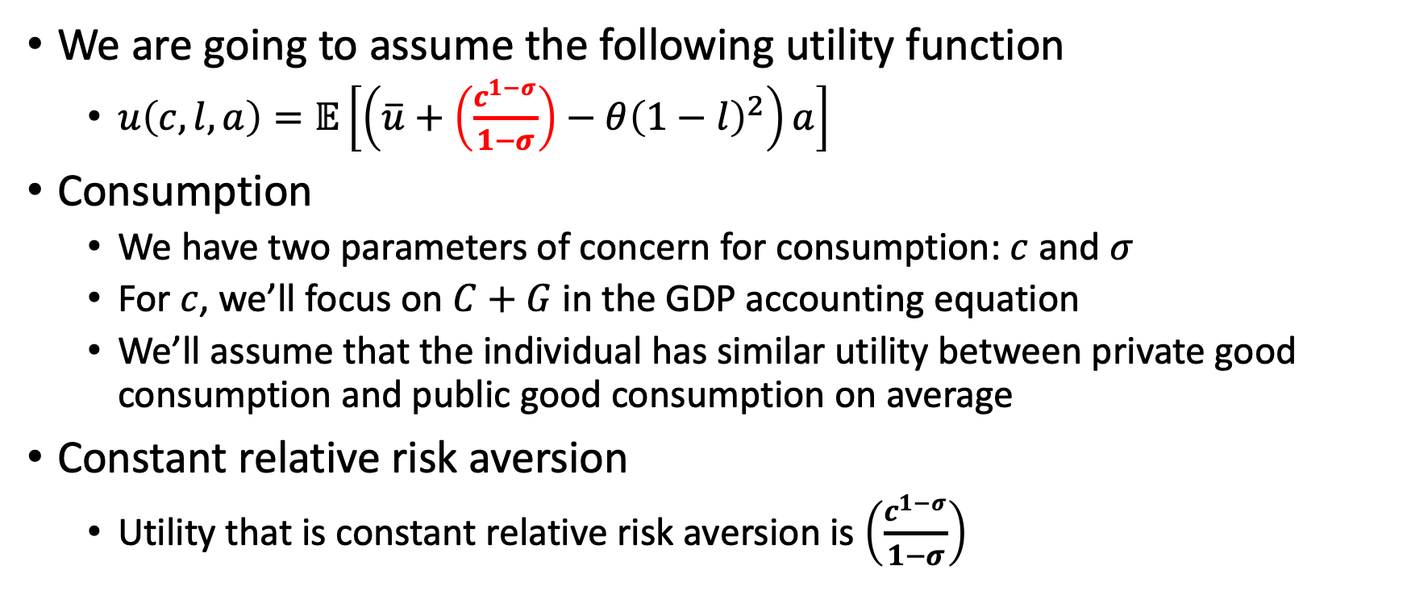
Beyond GDP: Consumption
We are going to assume the following utility function
$u\left(c,l,a\right)=𝔼\left[\left(\overline{u}+\left(\frac{c^{1−σ}}{1−σ}\right)−θ{\left(1−l\right)}^{2}\right)a\right]$
Consumption
We have two parameters of concern for consumption: $c$ and $σ$
For $c$, we’ll focus on $C+G$ in the GDP accounting equation
We’ll assume that the individual has similar utility between private good consumption and public good consumption on average
Constant relative risk aversion
Utility that is constant relative risk aversion is $\left(\frac{c^{1−σ}}{1−σ}\right)$

Slide 53
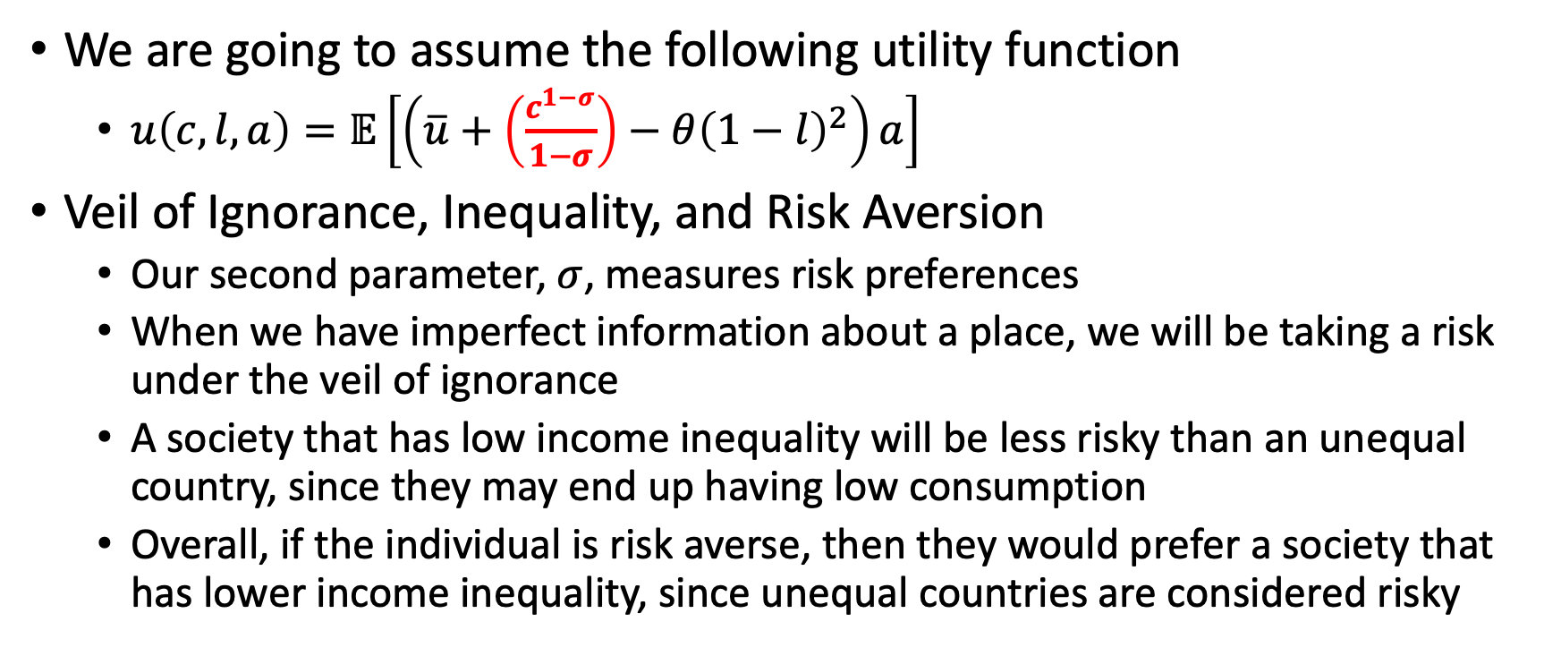
Beyond GDP: Inequality and Risk Aversion
We are going to assume the following utility function
$u\left(c,l,a\right)=𝔼\left[\left(\overline{u}+\left(\frac{c^{1−σ}}{1−σ}\right)−θ{\left(1−l\right)}^{2}\right)a\right]$
Veil of Ignorance, Inequality, and Risk Aversion
Our second parameter, $σ$, measures risk preferences
When we have imperfect information about a place, we will be taking a risk under the veil of ignorance
A society that has low income inequality will be less risky than an unequal country, since they may end up having low consumption
Overall, if the individual is risk averse, then they would prefer a society that has lower income inequality, since unequal countries are considered risky

Slide 54
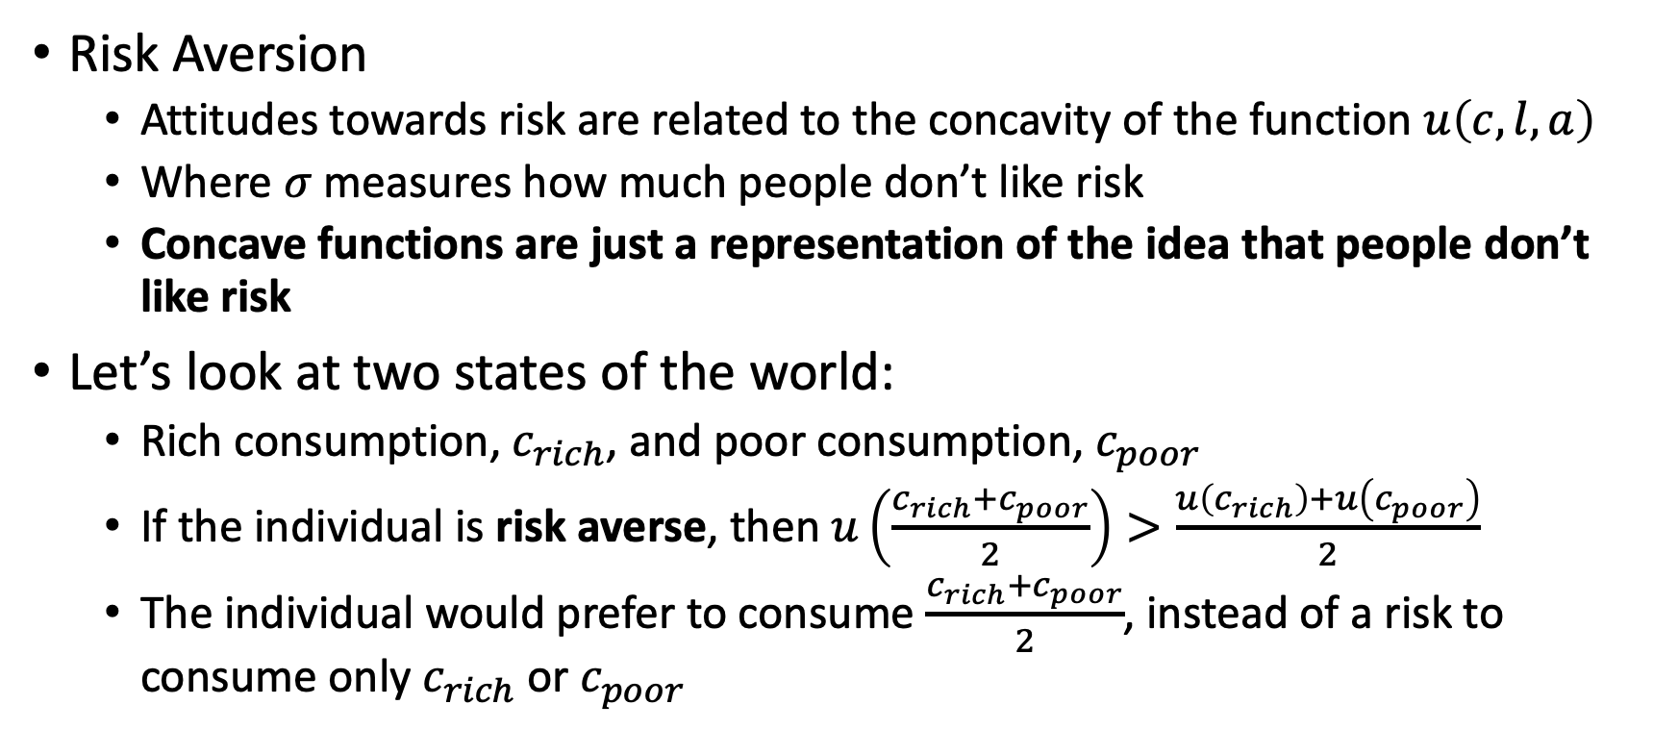
Beyond GDP: Inequality and Risk Aversion
Risk Aversion
Attitudes towards risk are related to the concavity of the function $u\left(c,l,a\right)$
Where $σ$ measures how much people don’t like risk
Concave functions are just a representation of the idea that people don’t like risk
Let’s look at two states of the world:
Rich consumption, $c_{rich}$, and poor consumption, $c_{poor}$
If the individual is risk averse, then $u\left(\frac{{c_{rich}+c}_{poor}}{2}\right)>\frac{u\left(c_{rich}\right)+u\left(c_{poor}\right)}{2}$
The individual would prefer to consume $\frac{{c_{rich}+c}_{poor}}{2}$, instead of a risk to consume only $c_{rich}$ or $c_{poor}$

Slide 55
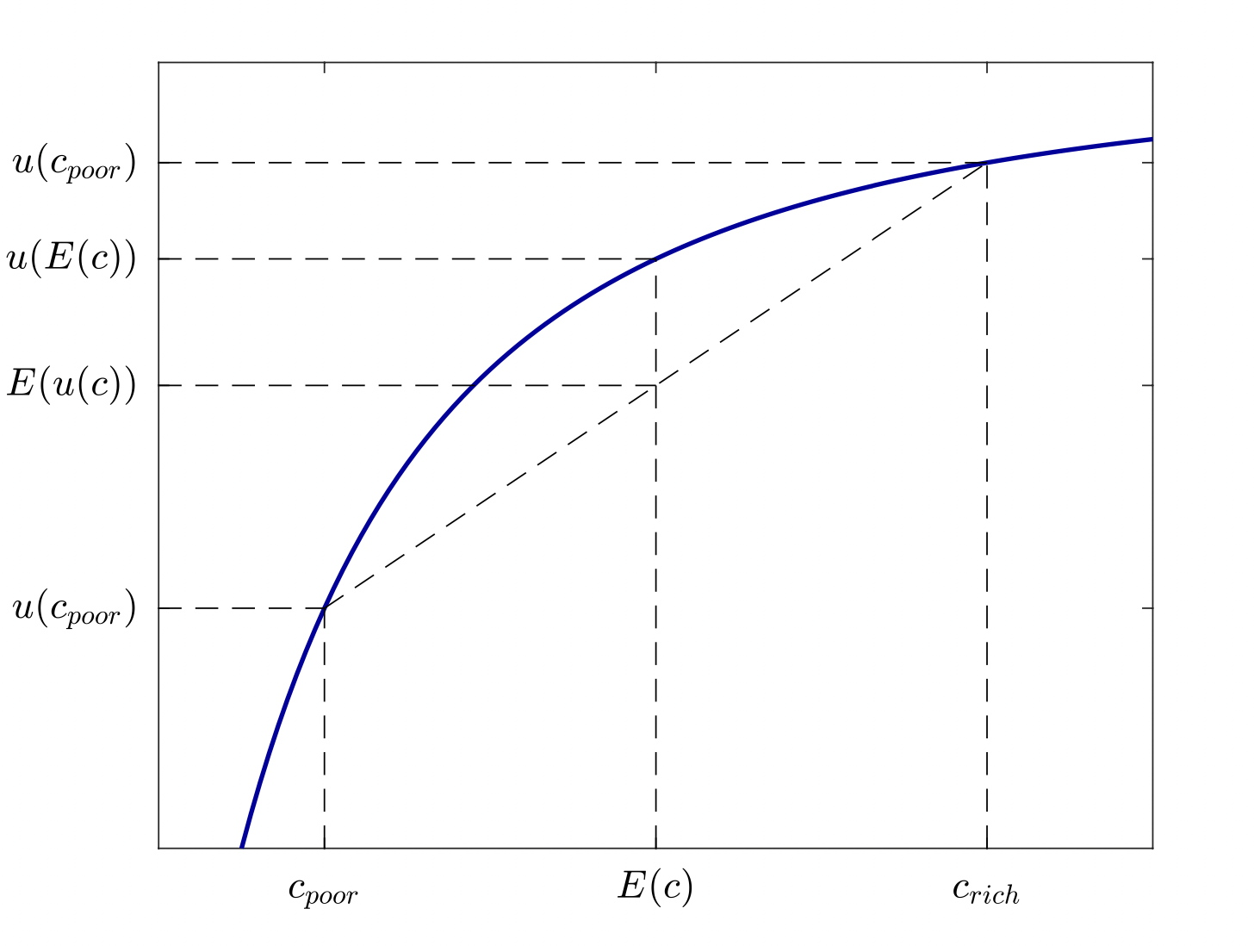
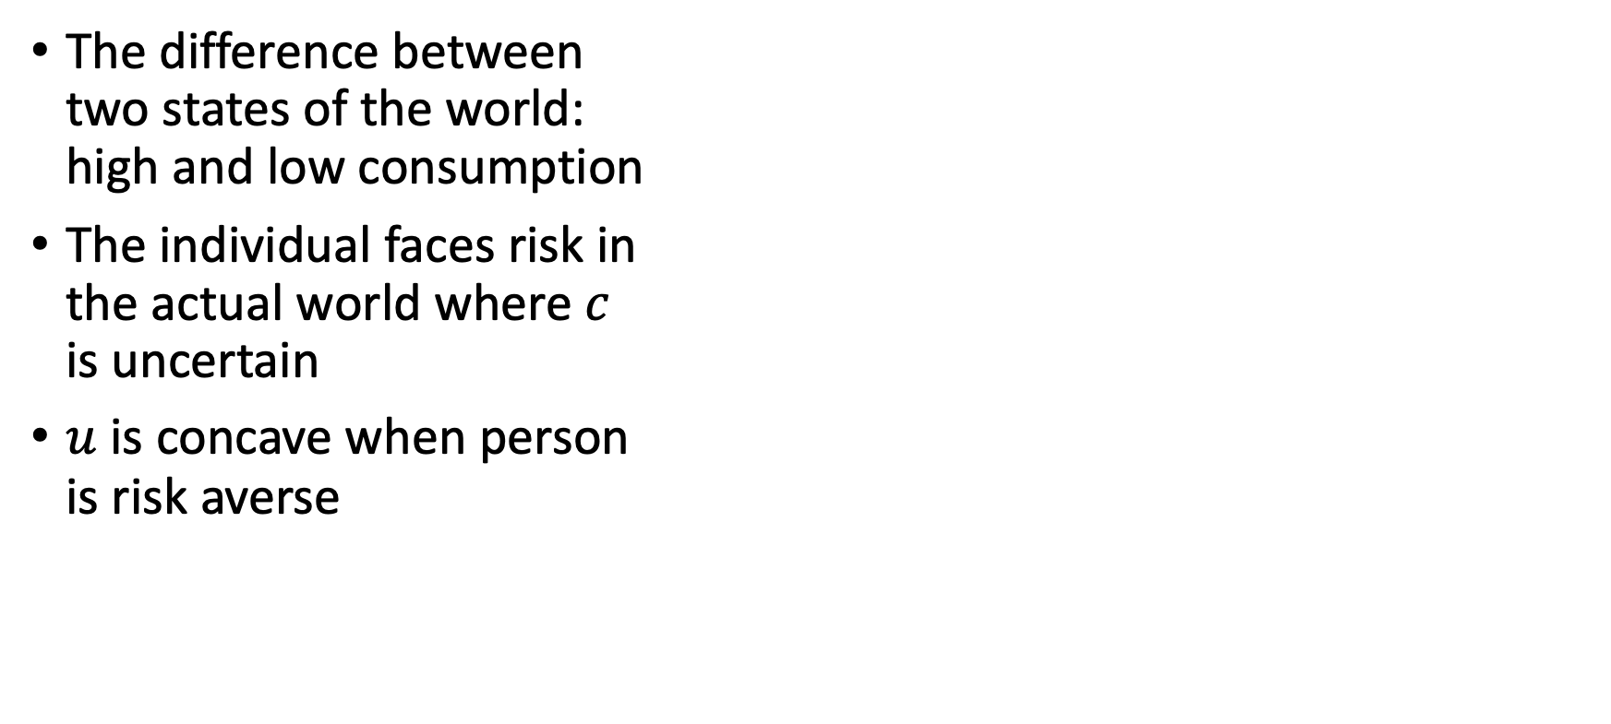
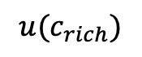
Beyond GDP: Inequality and Risk Aversion
The difference between two states of the world: high and low consumption
The individual faces risk in the actual world where $c$ is uncertain
$u$ is concave when person is risk averse
$$u(c_{rich})$$

Slide 56
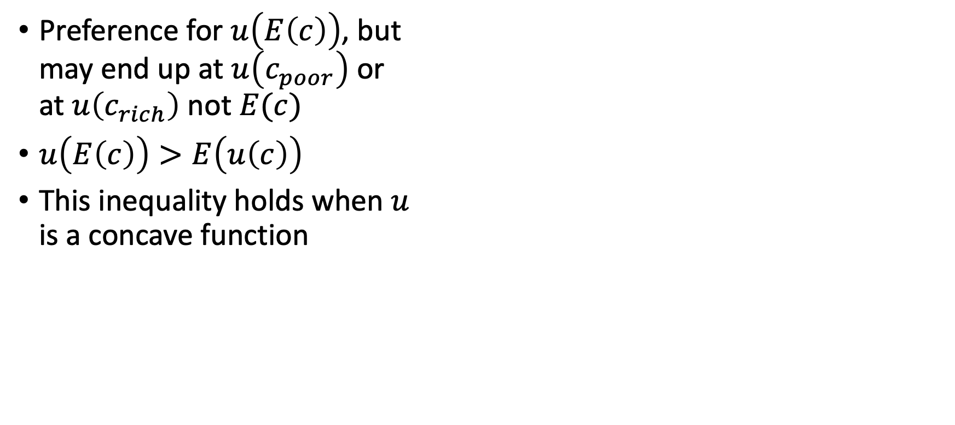
Beyond GDP: Inequality and Risk Aversion
Preference for $u\left(E\left(c\right)\right)$, but may end up at $u\left(c_{poor}\right)$ or at $u\left(c_{rich}\right)$ not $E(c)$
$u\left(E\left(c\right)\right)>E\left(u\left(c\right)\right)$
This inequality holds when $u$ is a concave function
$$u(c_{rich})$$

Slide 57
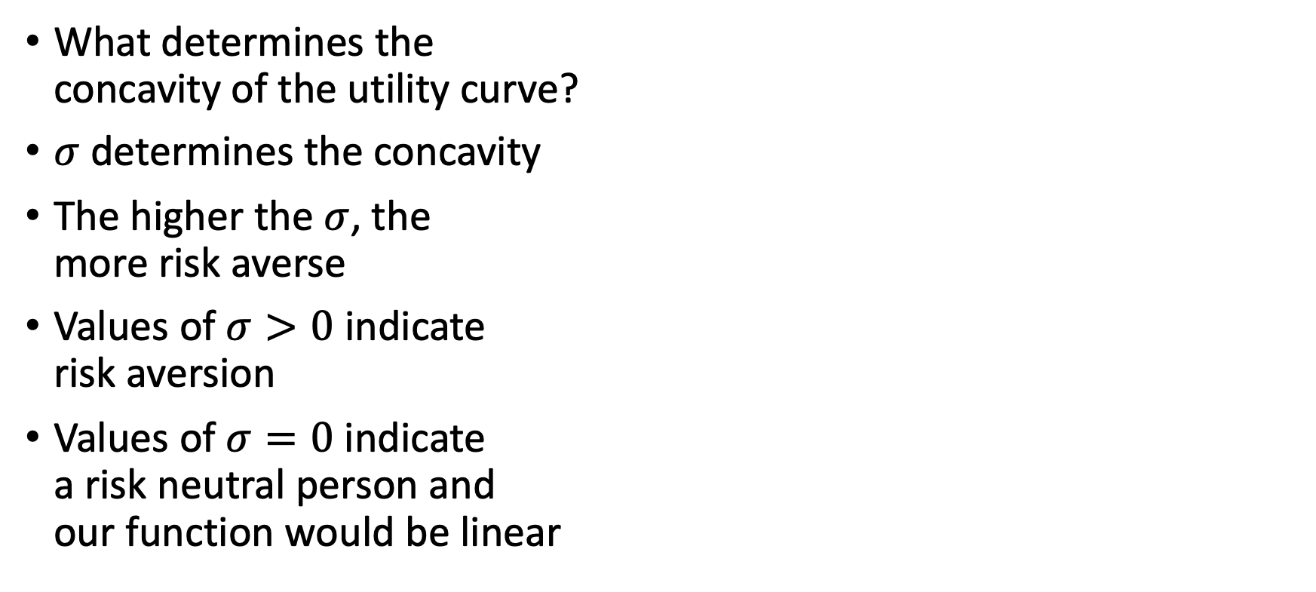
Beyond GDP: Inequality and Risk Aversion
What determines the concavity of the utility curve?
$σ$ determines the concavity
The higher the $σ$, the more risk averse
Values of $σ>0$ indicate risk aversion
Values of $σ=0$ indicate a risk neutral person and our function would be linear
$$u(c_{rich})$$

Slide 58
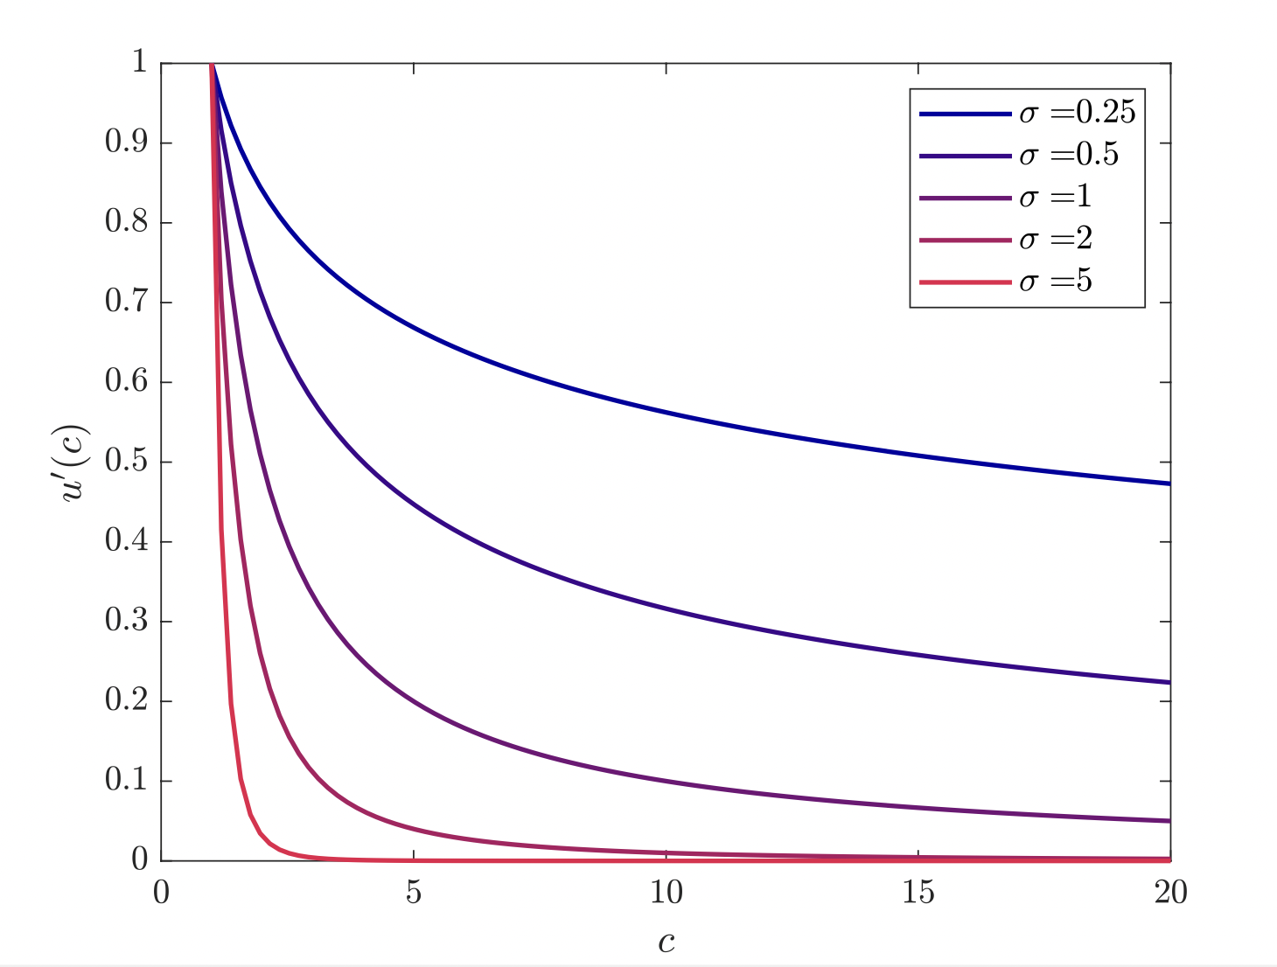
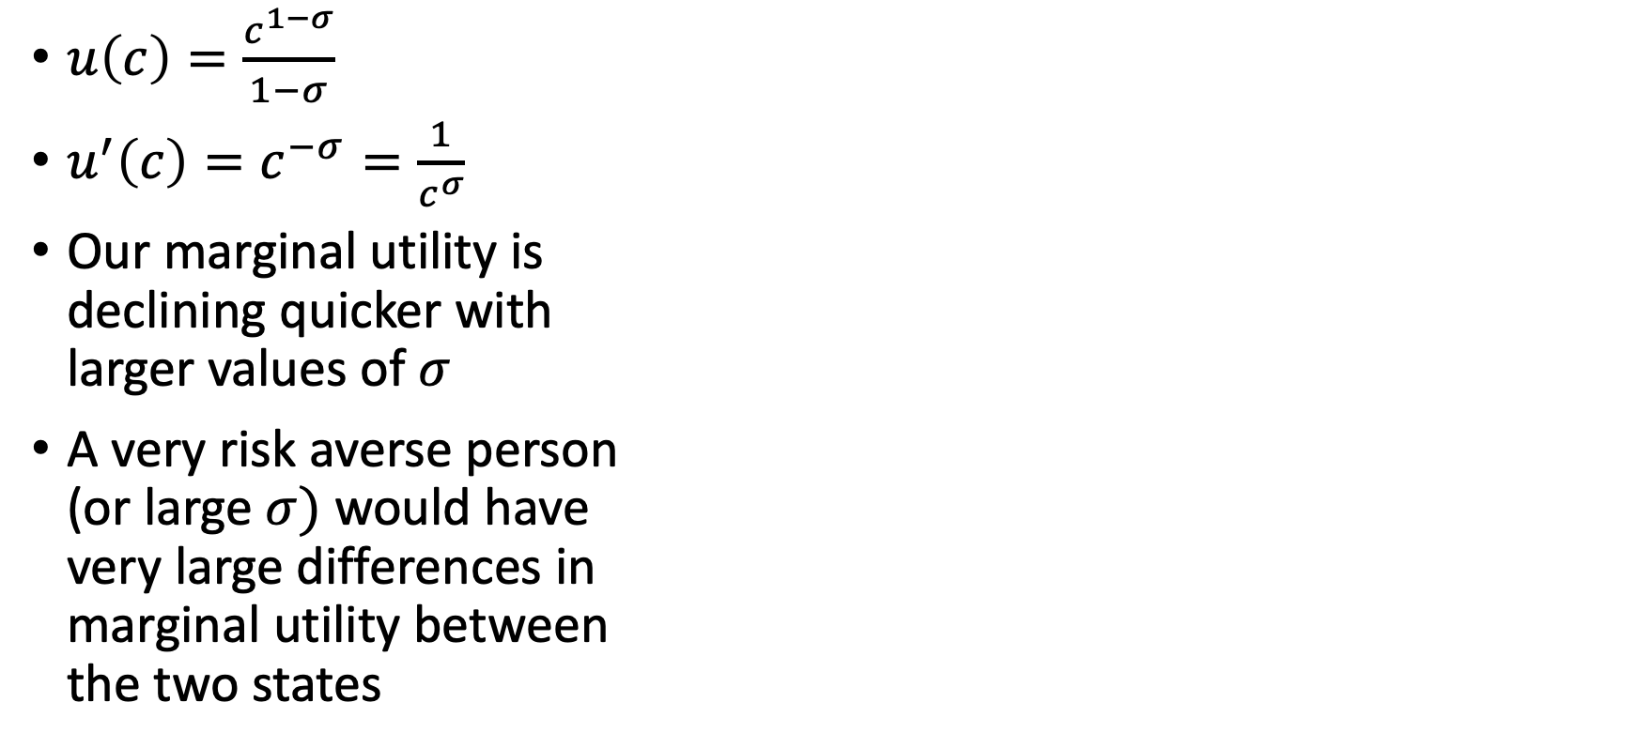
Beyond GDP: Inequality and Risk Aversion
$u\left(c\right)=\frac{c^{1−σ}}{1−σ}$
$u^{′}\left(c\right)=c^{−σ}=\frac{1}{c^{σ}}$
Our marginal utility is declining quicker with larger values of $σ$
A very risk averse person (or large $σ)$ would have very large differences in marginal utility between the two states

Slide 59
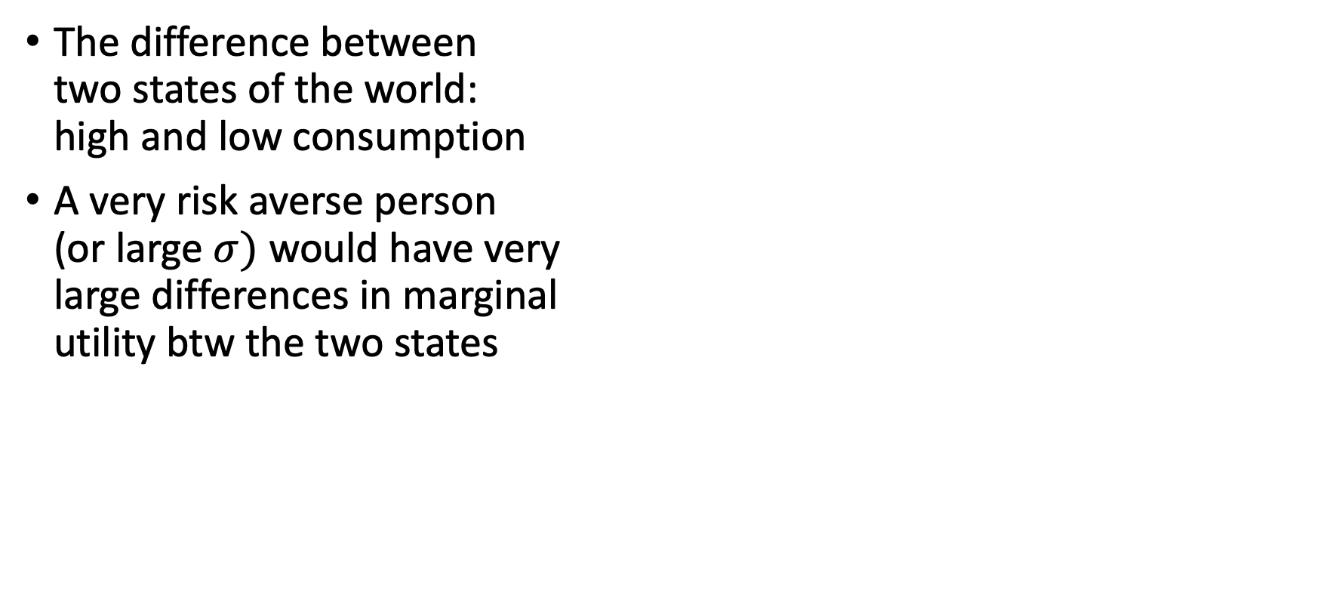
Beyond GDP: Inequality and Risk Aversion
The difference between two states of the world: high and low consumption
A very risk averse person (or large $σ)$ would have very large differences in marginal utility btw the two states

Slide 60
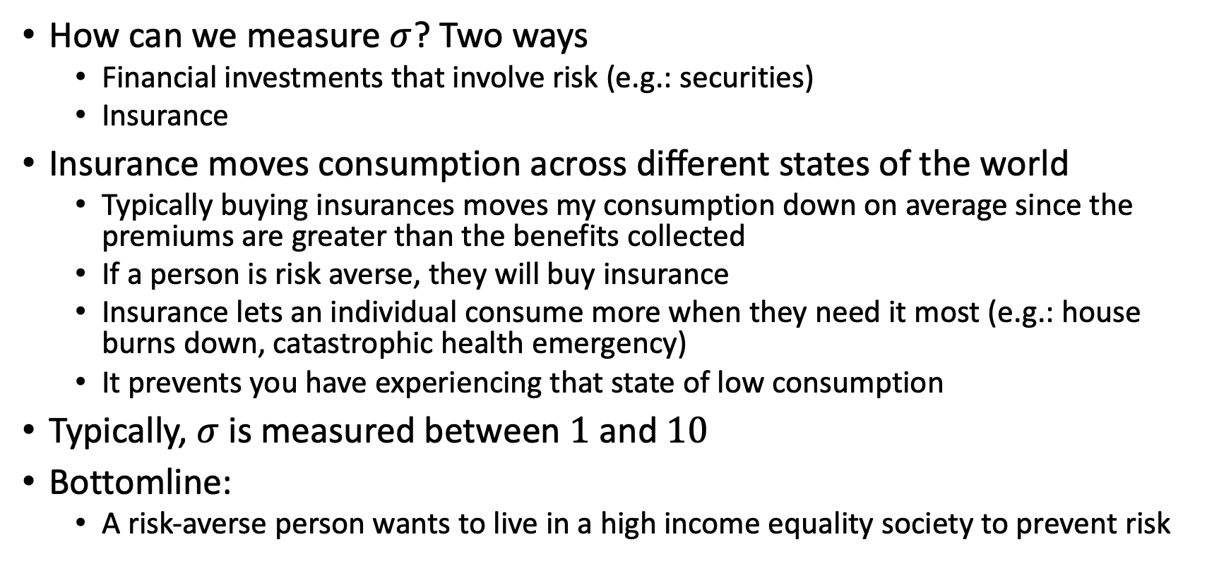
Beyond GDP: Inequality and Risk Aversion
How can we measure $σ$? Two ways
Financial investments that involve risk (e.g.: securities)
Insurance
Insurance moves consumption across different states of the world
Typically buying insurances moves my consumption down on average since the premiums are greater than the benefits collected
If a person is risk averse, they will buy insurance
Insurance lets an individual consume more when they need it most (e.g.: house burns down, catastrophic health emergency)
It prevents you have experiencing that state of low consumption
Typically, $σ$ is measured between $1$ and $10$
Bottomline:
A risk-averse person wants to live in a high income equality society to prevent risk

Slide 61
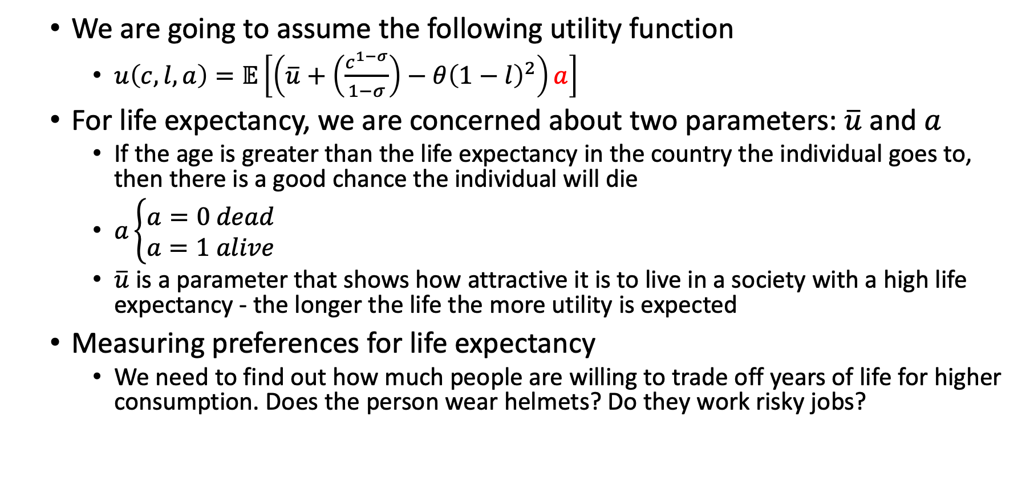
Beyond GDP: Value of Life Expectancy
We are going to assume the following utility function
$u\left(c,l,a\right)=𝔼\left[\left(\overline{u}+\left(\frac{c^{1−σ}}{1−σ}\right)−θ{\left(1−l\right)}^{2}\right)a\right]$
For life expectancy, we are concerned about two parameters: $\overline{u}$ and $a$
If the age is greater than the life expectancy in the country the individual goes to, then there is a good chance the individual will die
$a\left\{\begin{aligned}a=0 dead \\ a=1 alive\end{aligned}\right.$
$\overline{u}$ is a parameter that shows how attractive it is to live in a society with a high life expectancy - the longer the life the more utility is expected
Measuring preferences for life expectancy
We need to find out how much people are willing to trade off years of life for higher consumption. Does the person wear helmets? Do they work risky jobs?

Slide 62
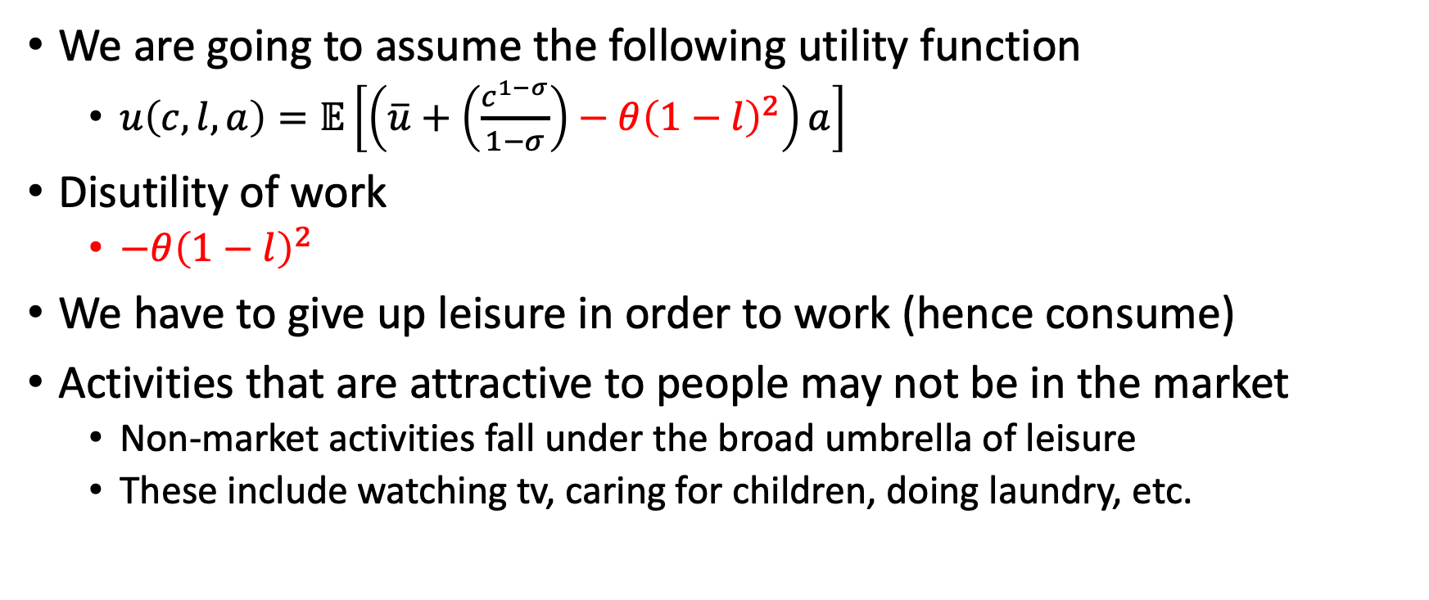
Beyond GDP: Value of Leisure
We are going to assume the following utility function
$u\left(c,l,a\right)=𝔼\left[\left(\overline{u}+\left(\frac{c^{1−σ}}{1−σ}\right)−θ{\left(1−l\right)}^{2}\right)a\right]$
Disutility of work
$−θ{\left(1−l\right)}^{2}$
We have to give up leisure in order to work (hence consume)
Activities that are attractive to people may not be in the market
Non-market activities fall under the broad umbrella of leisure
These include watching tv, caring for children, doing laundry, etc.

Slide 63
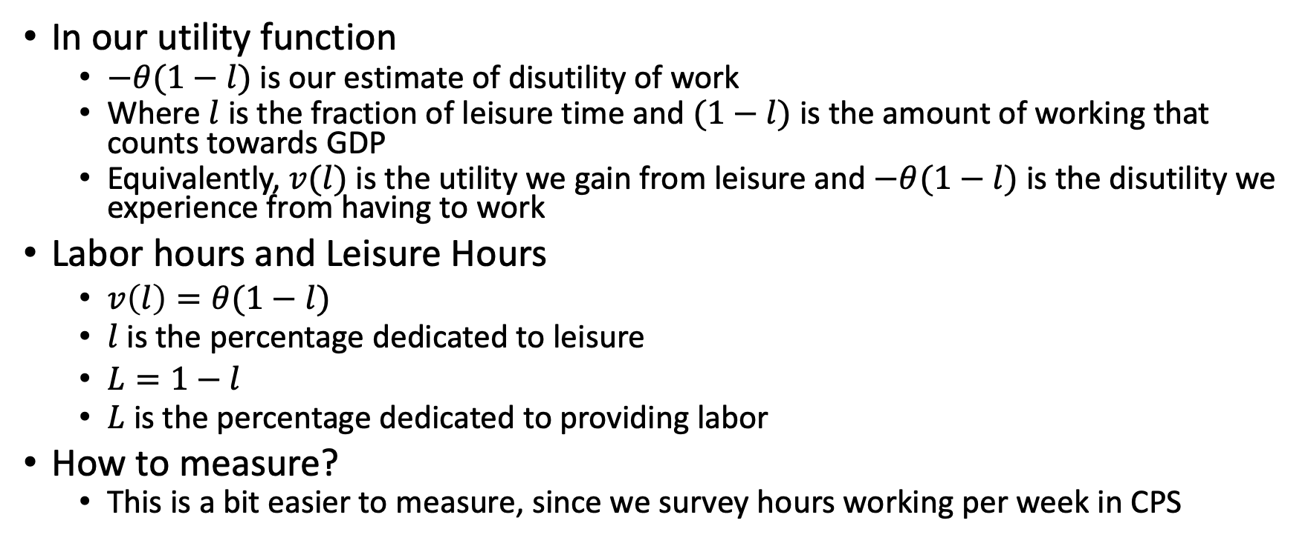
Beyond GDP: Value of Leisure
In our utility function
$−θ(1−l)$ is our estimate of disutility of work
Where $l$ is the fraction of leisure time and $(1−l)$ is the amount of working that counts towards GDP
Equivalently, $v(l)$ is the utility we gain from leisure and $−θ(1−l)$ is the disutility we experience from having to work
Labor hours and Leisure Hours
$v\left(l\right)=θ(1−l)$
$l$ is the percentage dedicated to leisure
$L=1−l$
$L$ is the percentage dedicated to providing labor
How to measure?
This is a bit easier to measure, since we survey hours working per week in CPS

Slide 64
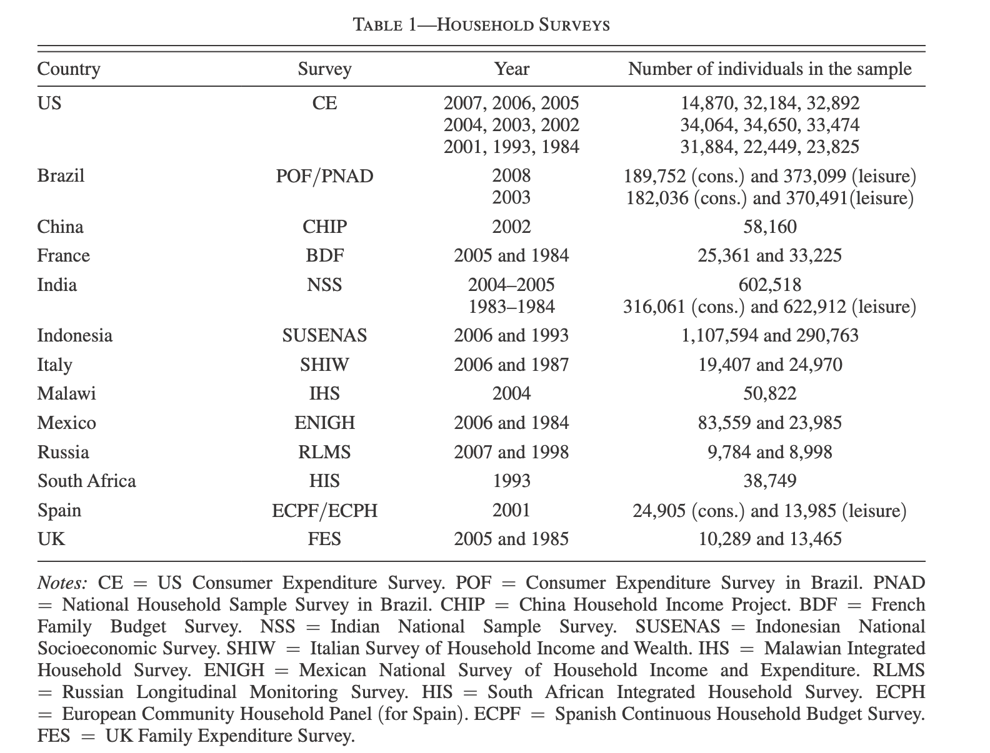
Beyond GDP
Data sources to measures consumption and leisure for microdata
WHO for life expectancy
Inequality: Gini coefficients
For microdata: Peen world tables

Slide 65
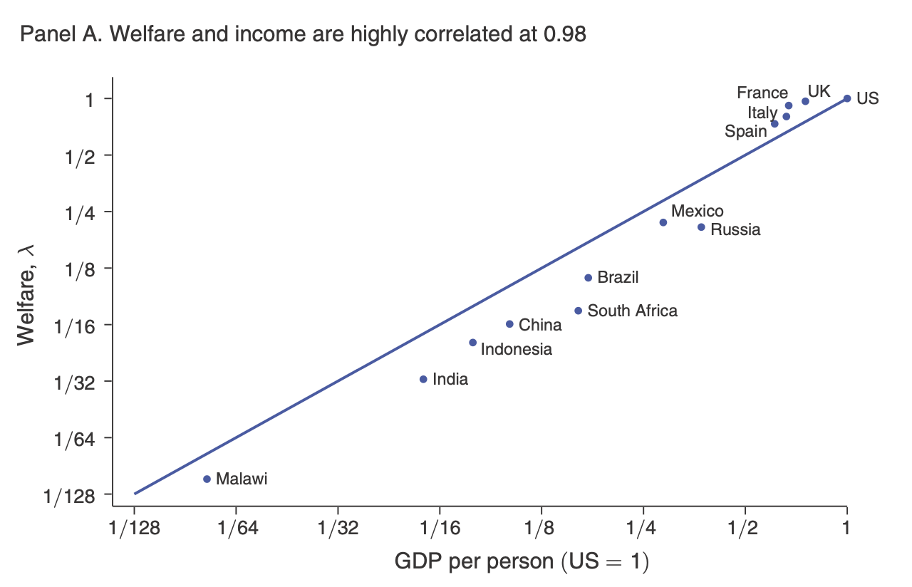
Results
Key Point: GDP per person is a good indicator for welfare/ well-being across a broad range of countries

Slide 66
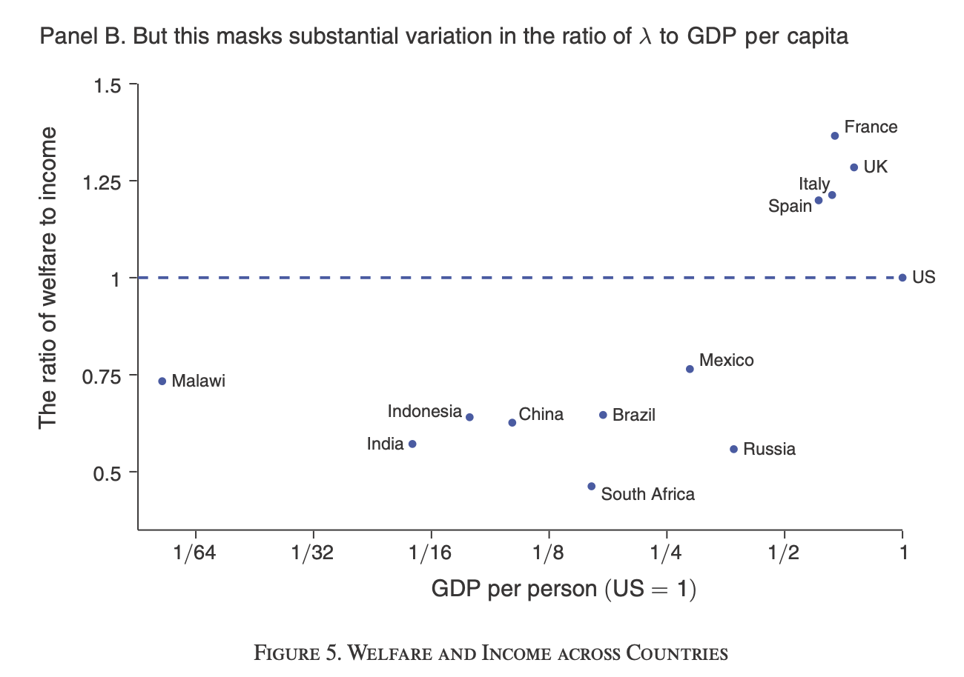
Results
Key Point: Western European living standards are much closer to the US when accounting for Europe’s longer life expectancy, more leisure, and lower inequality
There are sizeable deviations between welfare and GDP per capita

Slide 67
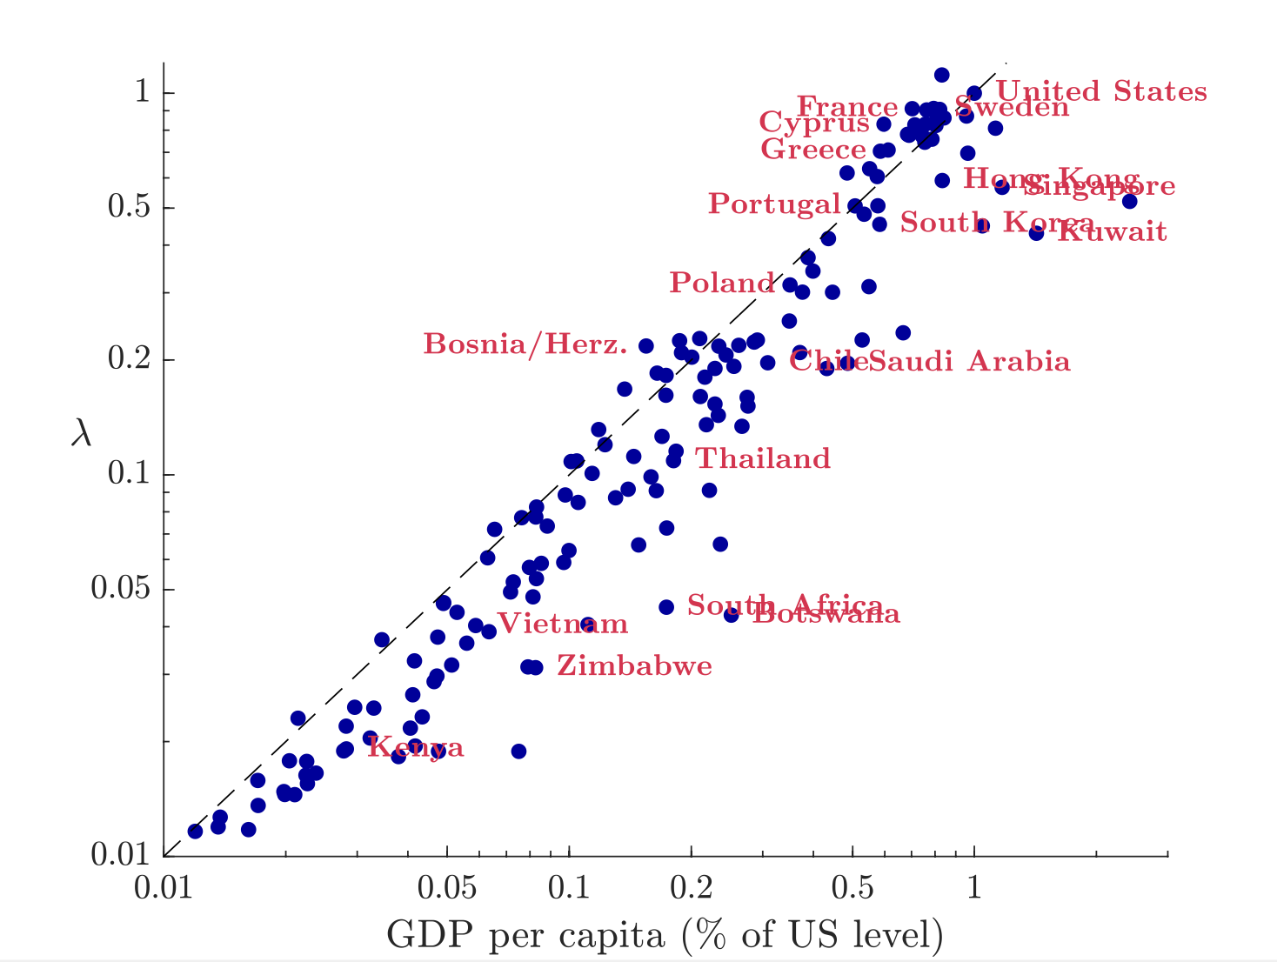
Results
Key Point: Many developing countries are poorer than GDP per capita suggest due to shorter life- spans, low consumption, and high income inequality

Slide 68
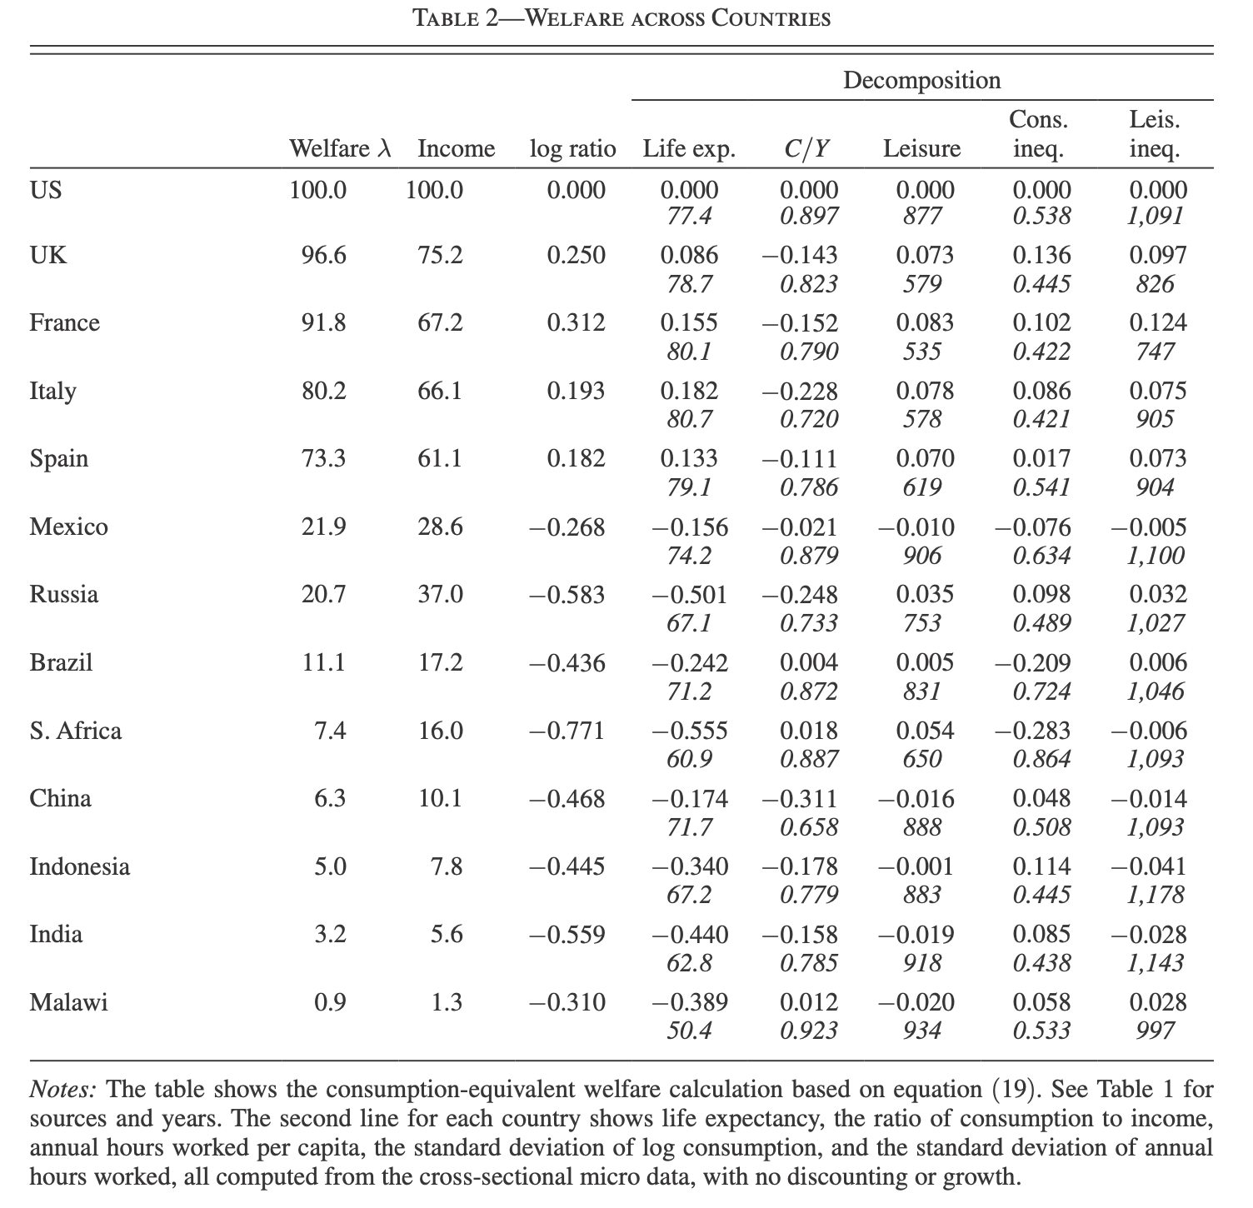
Results
Western Europe has lower consumption, higher lifespans, more leisure, and lower inequality
Developing countries have shorter lifespans, lower consumption, and/or worse inequality

